Slide 1
LWA Science Overview
Namir Kassim
LWA1 Radio Observatory Chief Scientist
LWA Project Scientist
Naval Research Laboratory

Slide 2
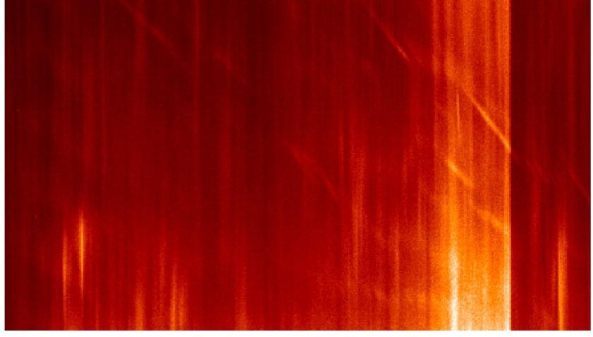
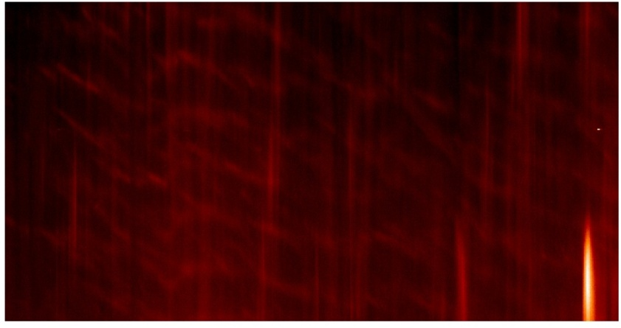
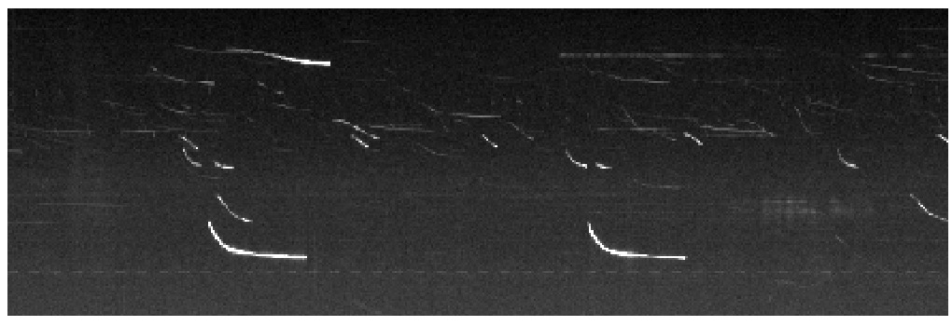
LWA1 Science Priorities I
Cas/Cyg ratio (with outlier - flux calibration, primary beam shape)
Time Variability
Spectrum vis a vis internal thermal absorption
Solar (spectral & temporal performance, DR)
256 dipoles better than 1 – weaker substructure apparent whenever we look
(courtesy S. White)

Slide 3
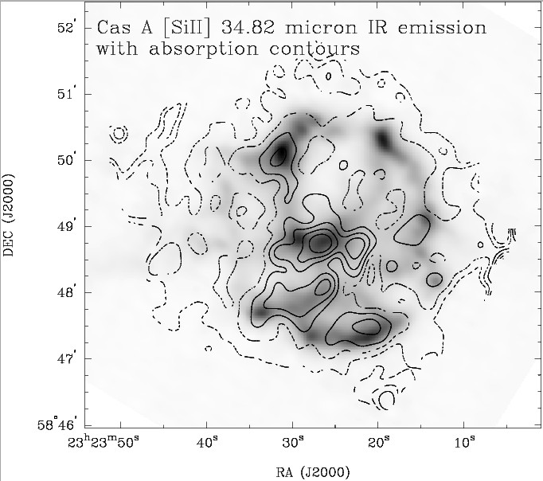
Cas A LWA1 Science (modest 74 MHz absorption grows for LWA1)
The Standard Formula
where
Using this formula Kassim et al 1995, ApJ, 455, L59 estimated 16 Msun of ejecta on the inside
Very Very Bad!
(But Tracey Delaney fixed it, & LWA1 can extend this & teach us about the ISM too!)
Comparing 6 cm, 20 cm, 90 cm, and 4 m
Losing light at 4 m
Free-free absorption from unshocked ejecta

Slide 4
LWA Science Priorities II
Jupiter (ditto sun, a little harder, esp. polarization)
Polarization characteristics
Pulsars (strongest system integrity metric)
Especially fast pulsars - also the most difficult
RRLs (test deep integration in our RFI environment)
Probe cold ISM, new observations motivated
Ionosphere/Troposphere (mitigation a pre-requisite)
VLA VHF science drawing attention, LWA passive radar now demonstrated
New field emerging – AGU session this fall
Space weather $$ (w\sun, attract larger community)

Slide 5
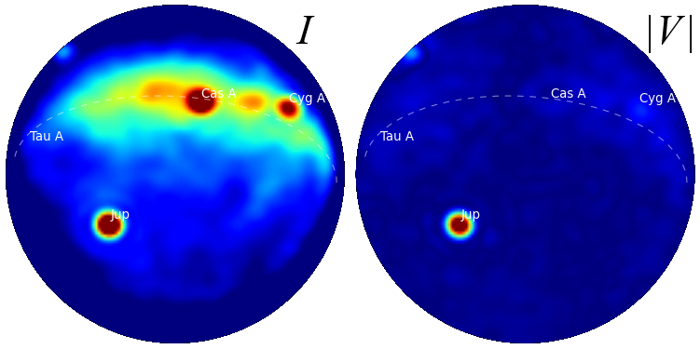
LWA Science Priorities III
Nature paper science: Transients, Hot Jupiters, Dark Ages: Exciting, though needn’t be our bread & butter at this stage
All systems important to exercise at this stage
E.g. PASI & DRX
Study our Jupiter to find more!

Slide 6
LWA1 Science Web Site
LWA science web site
Good place to find out what stuff is goin’ on
Learn lessons from other novices
Get ideas of things to try
Pretty pictures
LWA1 results web page: http://lwa1.freeforums.org/
A blog of all things good and bad
LWA Science Consortium Meetings
1st Wednesday of very month
Please contact me if you want to join

Slide 7
LWA1 Outreach: Folks starting to notice
SARA loves LWA
Want to use LWA antennas
Want to visit LWA site for regional meeting
More generally: folks like big dipole antennas
From professional engineers to HAMS & amateurs
LWA TV: Big hit, schools already using it
LWA antennas increasingly popular
For LoFASM, at UNAM, LWA @ OVRO, possibly for LOFAR superstations in Europe

Slide 8
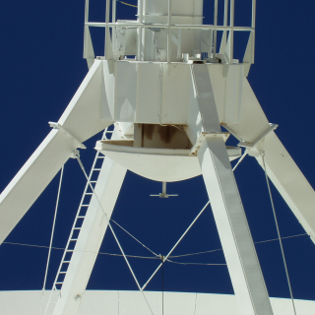
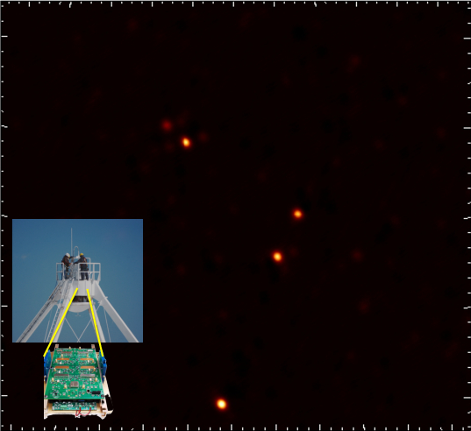
74 MHz System Upgrade: VLA “Low Band”
Replace legacy 74 & 330 MHz receivers with broadband 4 channel receiver covering ~56-470 MHz
Initial operation with existing 74 & 330 MHz feeds
Lower system temperature, broader bandwidth, improved RFI mitigation techniques
First light in January 2012, deployment to all 27 antennas continues during the year
http://www.nrl.navy.mil
GOODSN: 4 antennas
Courtesy: F. Owen

Slide 9
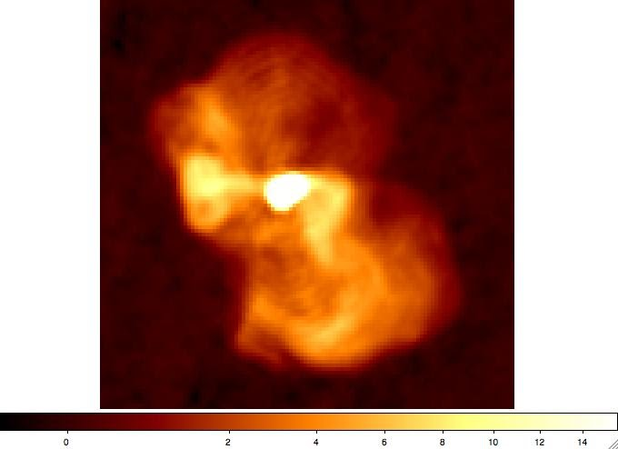
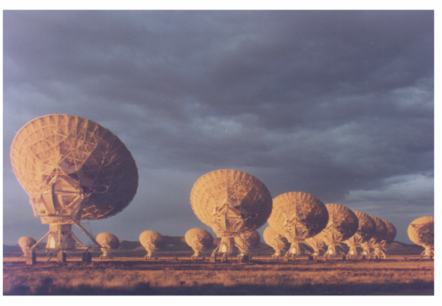
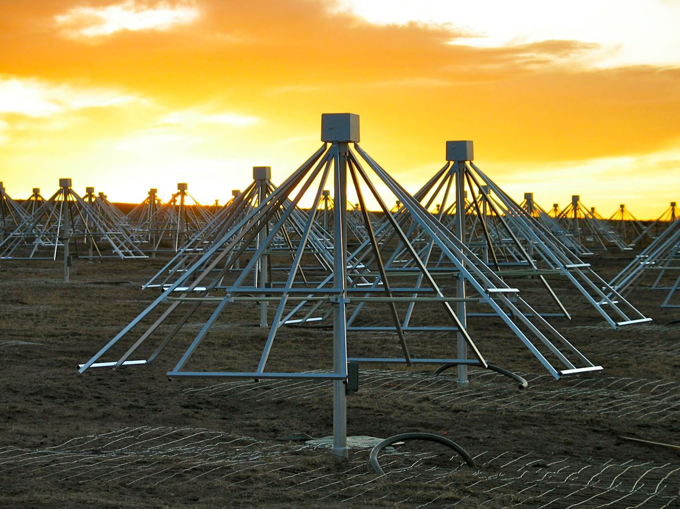
VLA LB Commensal System & LWA1
(warning: hypothetical!)
LWA 80 MHz Primary Element Beam
VLA Cassegrain: L-U bands
LWA 80 MHz Primary Station Beam
VLA 330 MHz Primary Beam
VLA 330 MHz Synthesized Beam

Slide 10
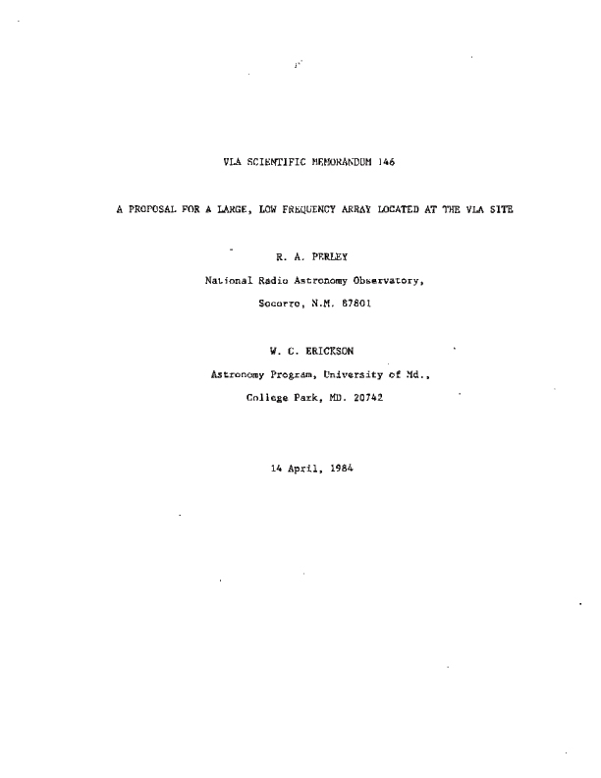
LWA Vision: Past is Prologue
LWA is NRAO memo 146 (1984)
No $$, built 74 MHz system instead
74 MHz VLA transitioning to wider band EVLA LB
Reasonable expectation: 60-80 MHz
Can EVLA LB beget LWA?
(also LWA1 memo #1)

Slide 11
LWA Vision: Expansion
LWA2 at A+ site (e.g. Horse Springs)
Ring of LWA stations at A+ sites
EVLA LB (60-80 MHz) as surrogate core
Especially cool if there is a VLA commensal system
Future steps
More stations both inside and outside A+ range
Extend to high resolution, full-field of view, full-frequency range mapping
Enter the pearly gates

Slide 12
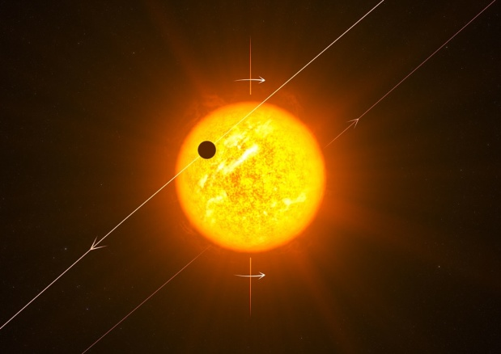
Summary
The game is on!
Anticipating rich science from LWA1 - reasonable that it starts modestly
Return of low frequencies to the EVLA bodes well for the LWA, whether we get beyond LWA1 soon or not
Suggestion: LWA “busy weeks”, perhaps for 1-2 people at a time

