Slide 1

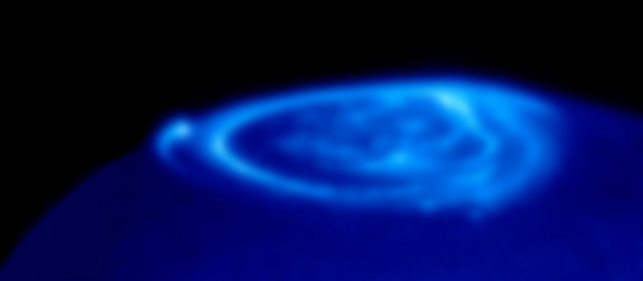
Jovian Emission with LWA1
Tracy Clarke – NRL

Slide 2
Project Collaborators
Jinhie Skarda (NRL SEAP/Montgomery Blair High School Junior): All the hard work.
Ted Jaeger (NRL-NRC): Analysis software and interpretation of results.
Chuck Higgins (MTSU): Scientific interpretation. Jovian emission expert and Radio Jove project developer.
Francisco Reyes (UF): Jovian emission expert, low frequency instrumentation expert.
Entire LWA team.

Slide 3
Science Goals
Characterize LWA-1 Polarization Properties
Develop Software and Analysis Techniques
Study Fine Temporal Structure and Spectral Structure of Jovian Bursts
Set the ground work for future initiatives
  Searches for extra-solar “Jupiters” (Hartman project)
Analysis software developed in python building on LSL package.

Slide 4
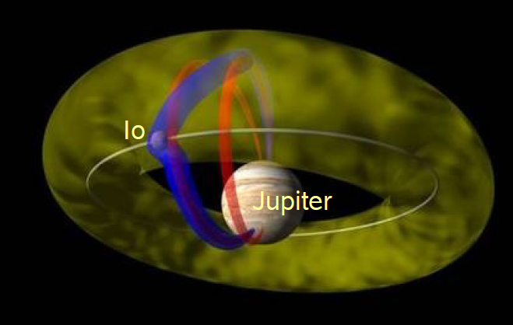
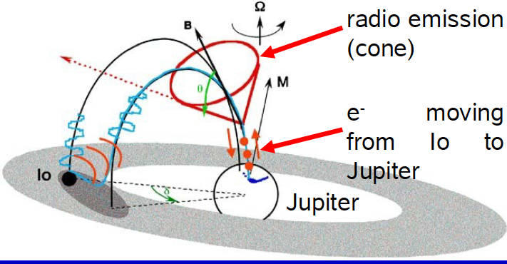
Emission Mechanism:
Cyclotron Maser Instability
keV electrons in Io torus are accelerated and spiral toward Jupiter
Depending on the electron pitch angle some will hit the upper atmosphere to create a hot spot while others will be reflected at a mirror point in the Jovian atmosphere.
The reflected electrons will be beamed in a hollow cone of intense emission

Slide 5
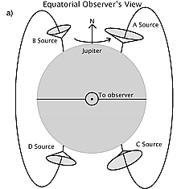
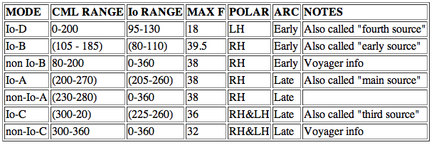
Jupiter Source Regions
A
B
D
C

Slide 6
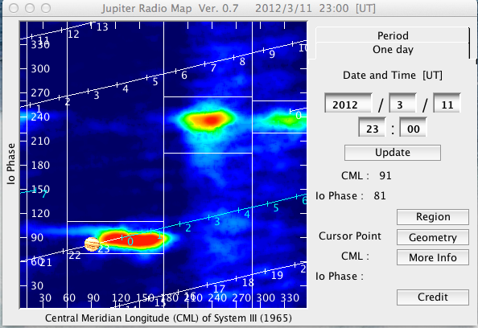
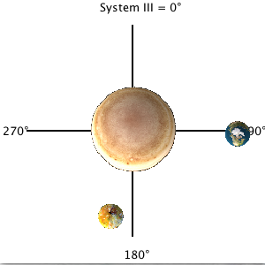
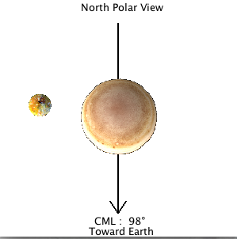
Observations
Target Jupiter during predicted burst times
Io-B: 055997
Io-A
Io-C
Io-B
Cover 10 – 34 MHz region with 2 tunings
Off-beam for bandpassing and RFI anti-coincidence (NCP, Cas A, Sun, M1)

Slide 7
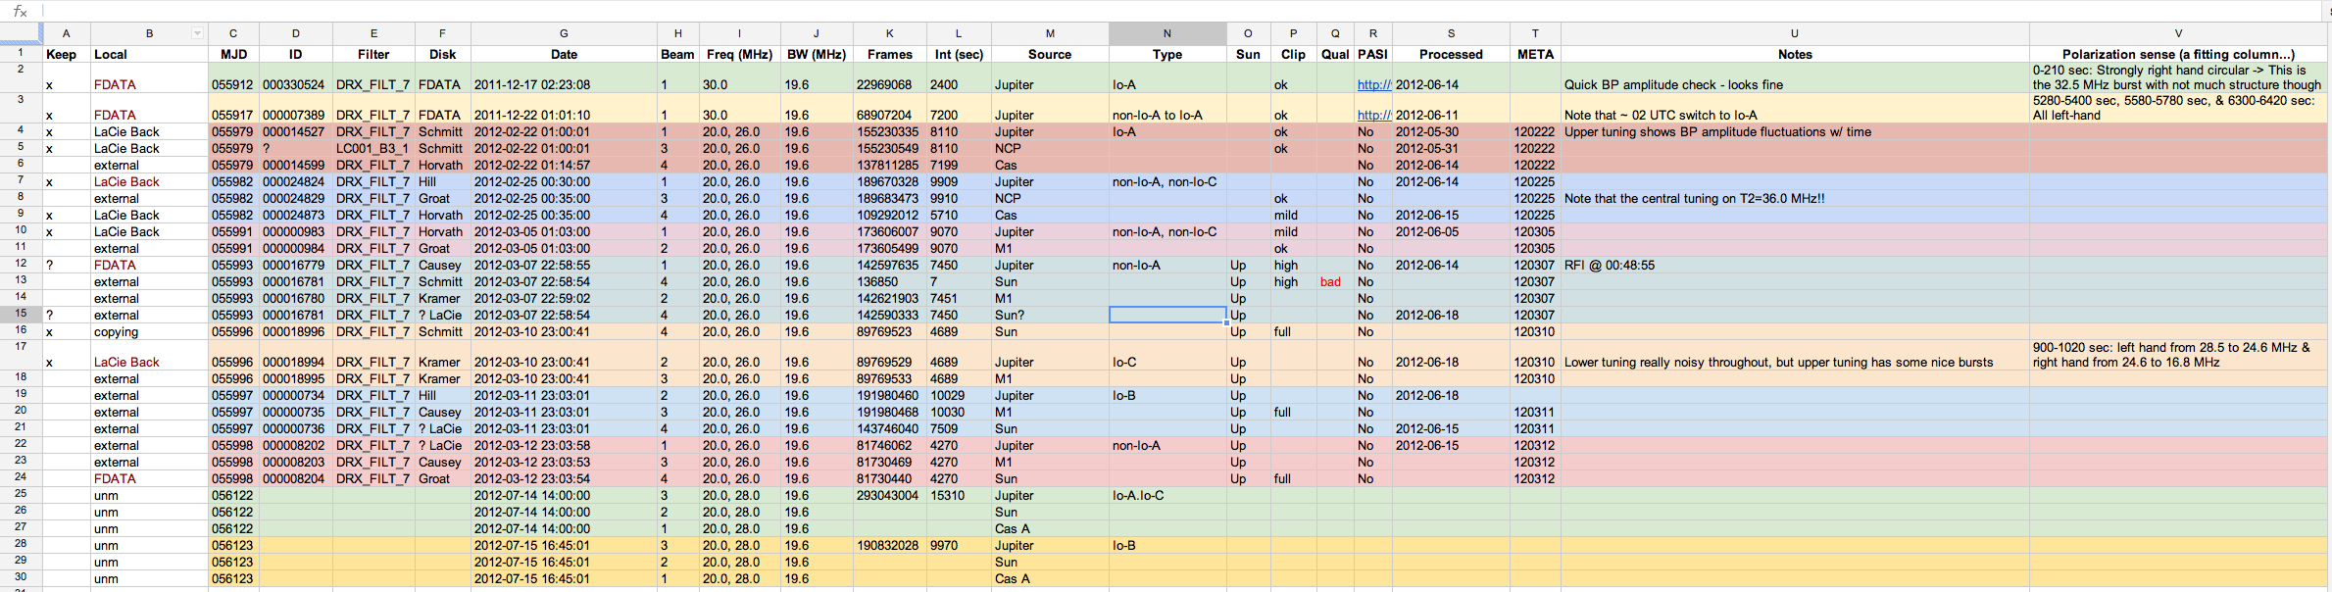
Observing Spreadsheet
Total on-Jupiter for LC001 = 22 h (+3h archive)

Slide 8
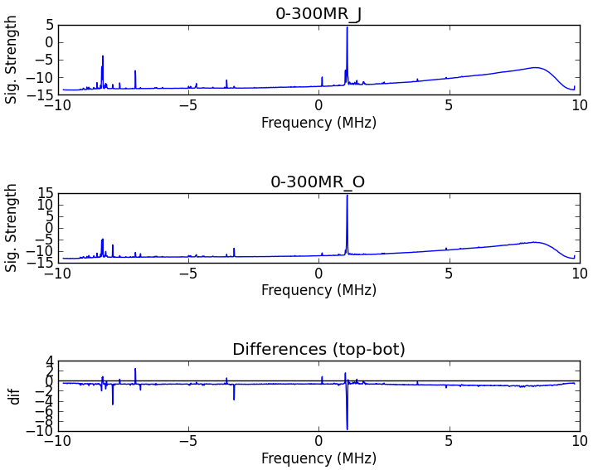
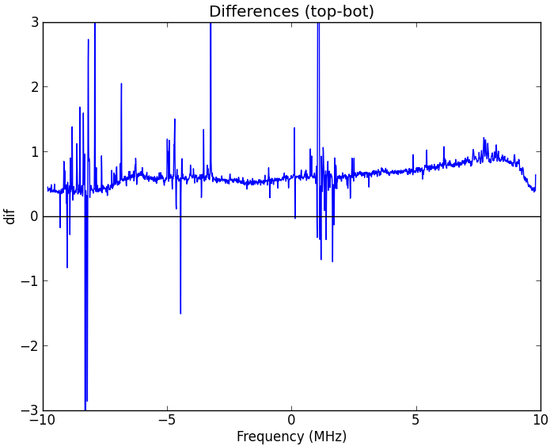
Bandpass Tests
Initial analysis on Io-A event with both tunings to BP
  Short to long median averages and compared R and L to determine Δt=5 minutes is good choice
  Compared on and off Jupiter to find off-Jupiter is better (preserves ambient non-burst emission)
  BP comparisons as a function of time show R and L track each other well but do have a time-variable shape
  BP with off-beam at same time as burst regions being studied in R and L separately
Difference (0-300s)-(2700-3000s)

Slide 9
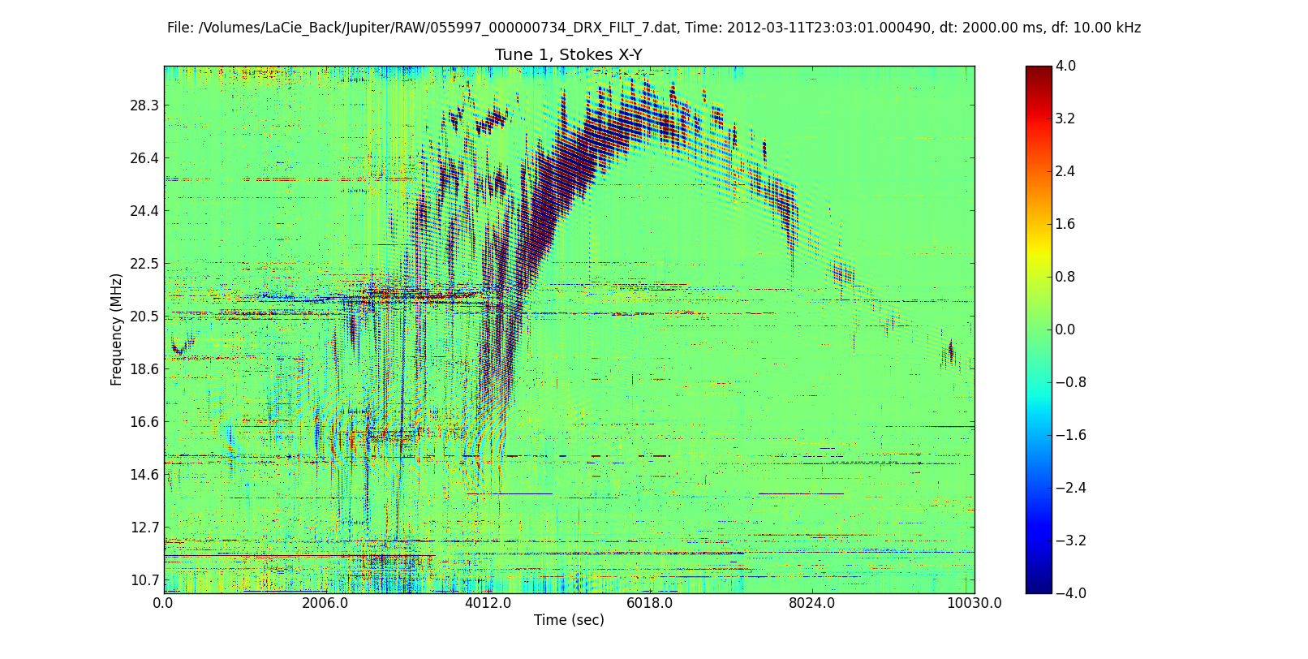
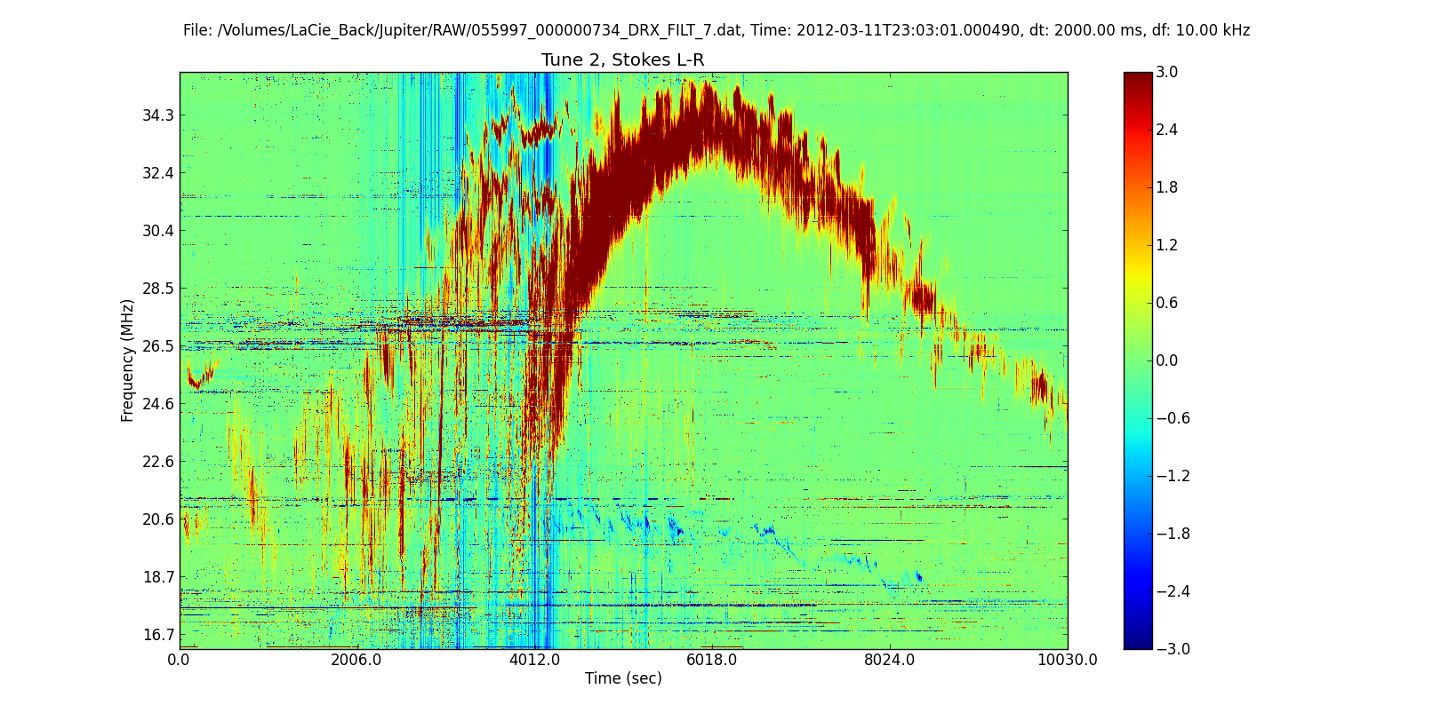
Io-B: 055997 (03/11/12)
Ionosphere-induced
Faraday Lanes

Slide 10
Io-B: 055997

Slide 11
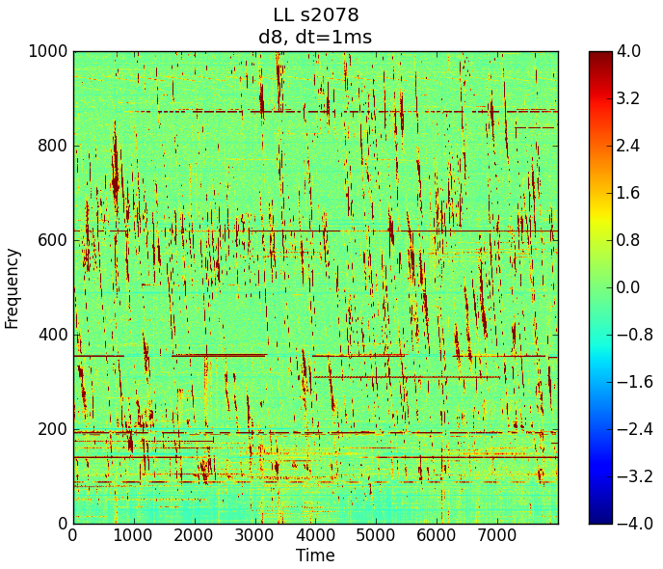
Io-B: 8s pre-burst

Slide 12
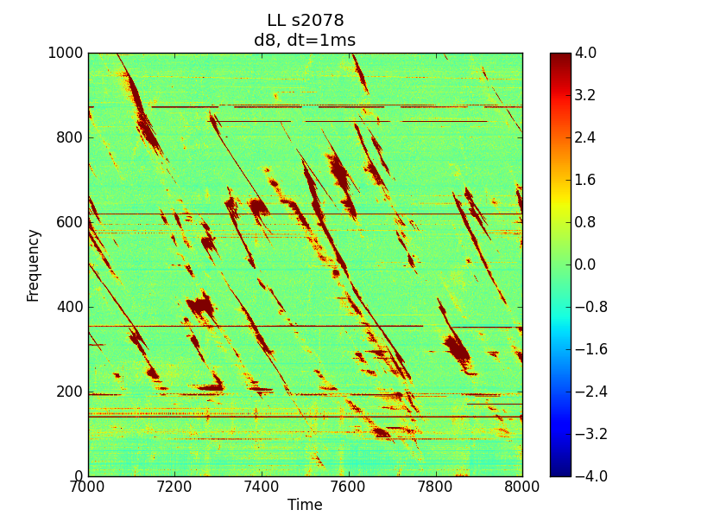
Io-B: S-Bursts
Origin under debate.
- may be cyclotron maser in flux tube connecting Io or Io’s wake to Jupiter
- slope change could be from a bipolar electrostatic structure in the Jovian auroral region

Slide 13
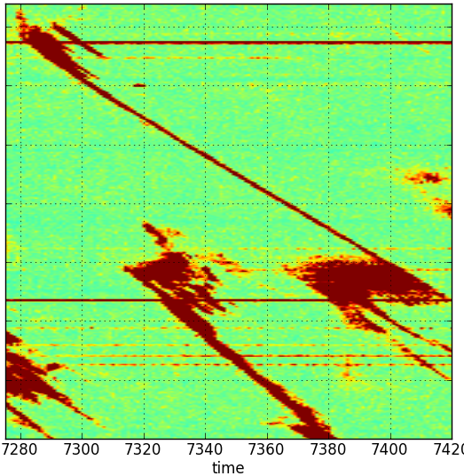
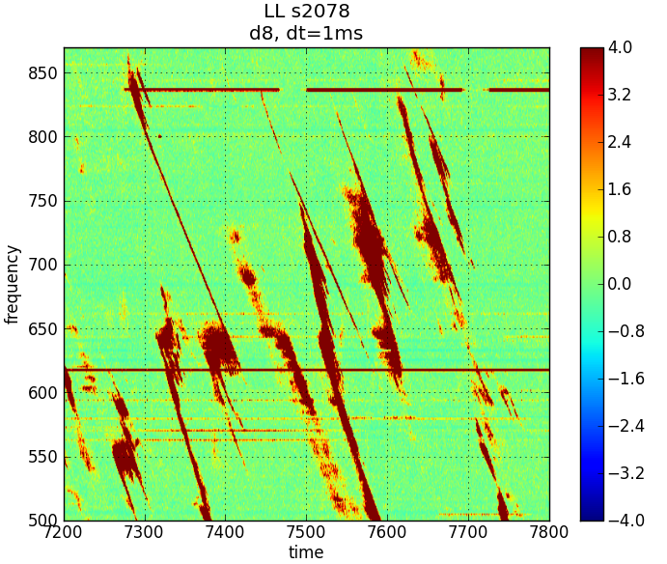
Io-B: S-Bursts
Δt~100 ms
Δν~ -15 MHz/s

Slide 14
Io-B: S-Burst/NB Interaction
Jupiter S-busts
  Δt=1-10’s ms
  Δν=-20 MHz/s
Δt~100 ms
Δν~ -15 MHz/s
Interaction: S-Bursts & Narrow Band emission
- narrow band emission seems to grown then by quenched by intersection with S-Burst and may grow again (F. Reyes, private communication)

Slide 15
Io-B: Circular Polarization Ratio

Slide 16
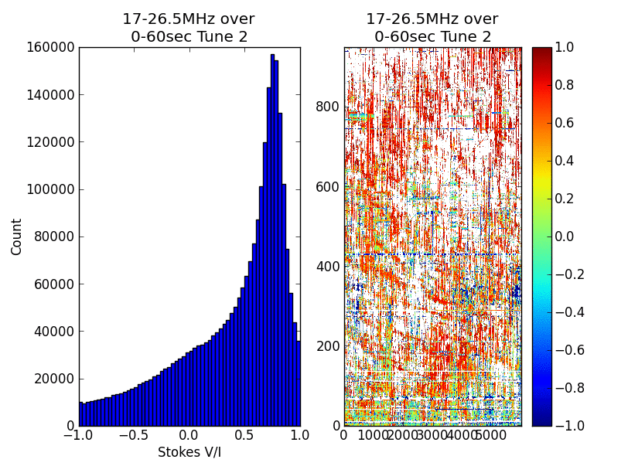
Io-B: Circular Polarization Ratio

Slide 17
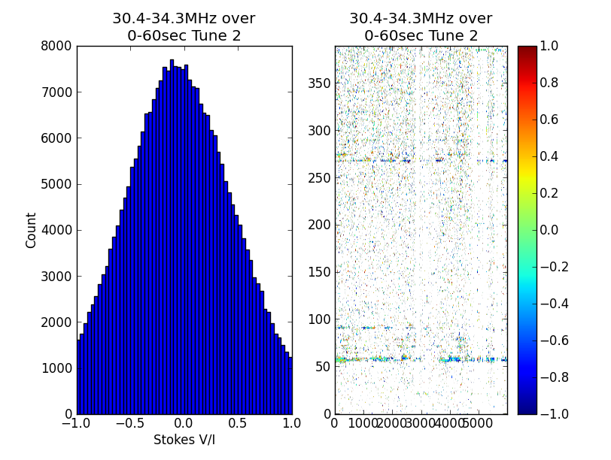
Io-B: V/I Noise Characteristics

Slide 18
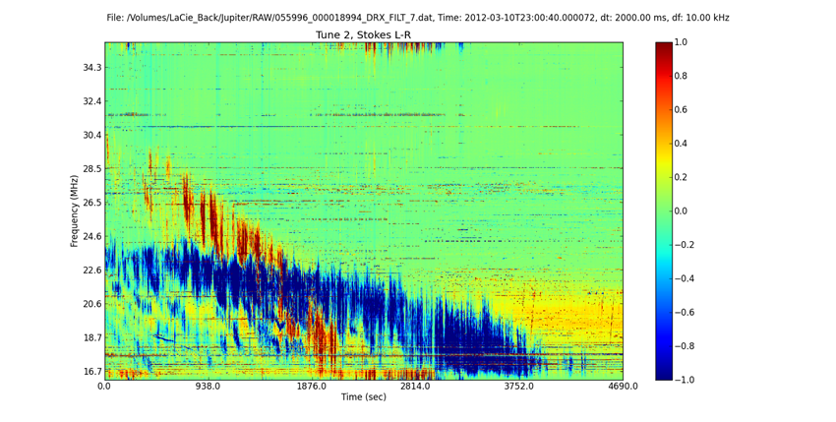
Io-C: 055996 (03/10/12)

Slide 19
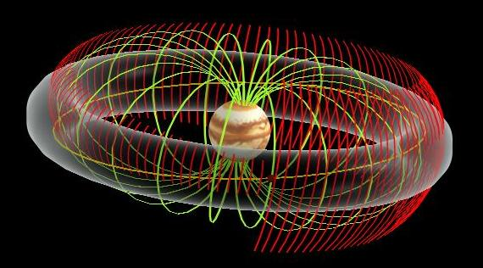
Modulation Lanes
Modulation lanes:
- cover entire frequency range
- positive and negative slopes
- frequency spacing 100-300 kHz
- drift rate 100 kHz/s
- depth few dB
Modulation lanes:
A) interference screen in outer Jovian magnetosphere or Io plasma torus
B) modulation due propagation through a region with transverse or quasi-transverse magnetic field;
C) modulation due to wave diffraction on drifting interplanetary disturbance;
D) modulations due to quasi-harmonic formations created by TIDs in Earth’s ionosphere that act as a diffraction screen
Notes:
interference screen in outer Jovian magnetosphere or Io plasma torus where field-aligned columns of enhanced plasma density scatters rays constructively and destructively with the unscattered rays; B) modulation due to Cotton-Mutton effect in Jupiter’s magnetosphere and ionosphere where the wave propagates through a region with transverse or quasi-transverse magnetic field; C) modulation due to wave diffraction on the drifting interplanetary disturbance; D) modulations due to quasi-harmonic formations created by TIDs in Earth’s ionosphere that act as a diffraction screen

Slide 20
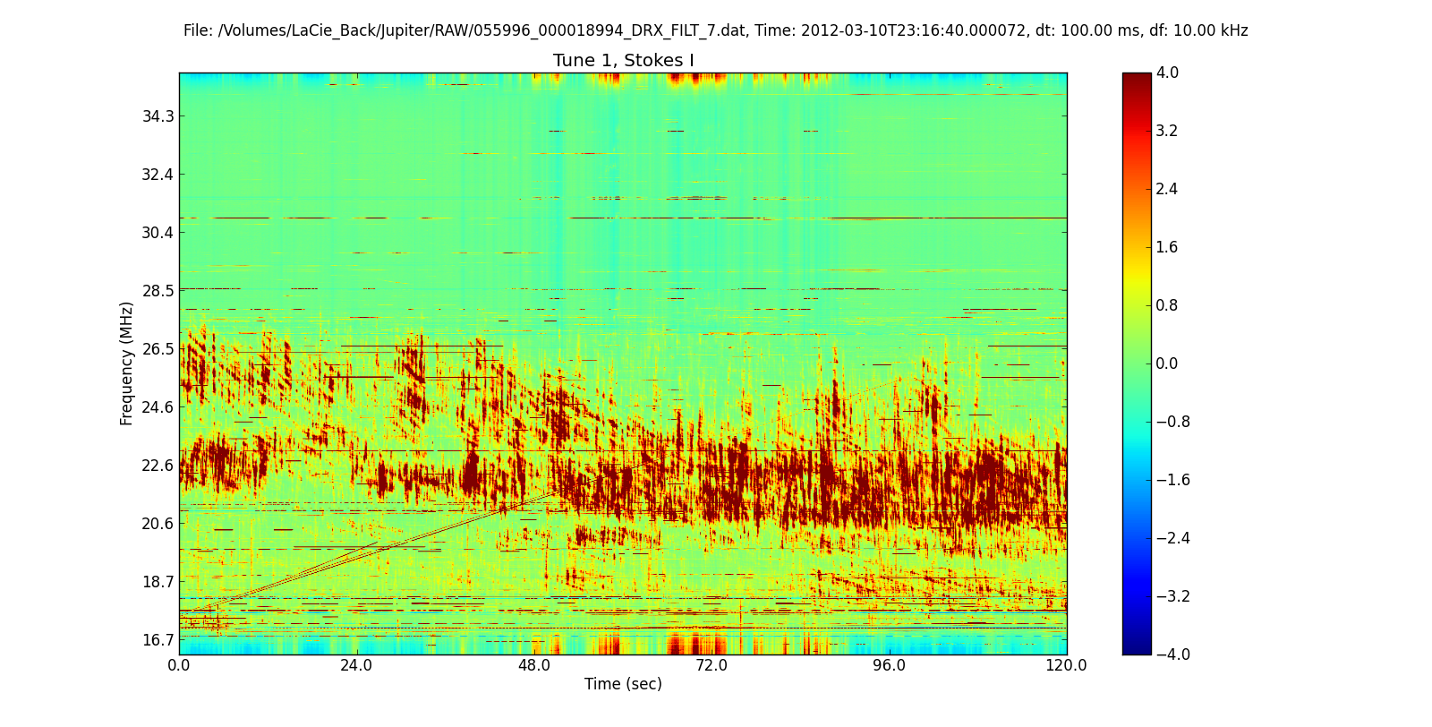
Io-C: Modulation Lanes!
Rare Io-C Modulations Lanes

Slide 21
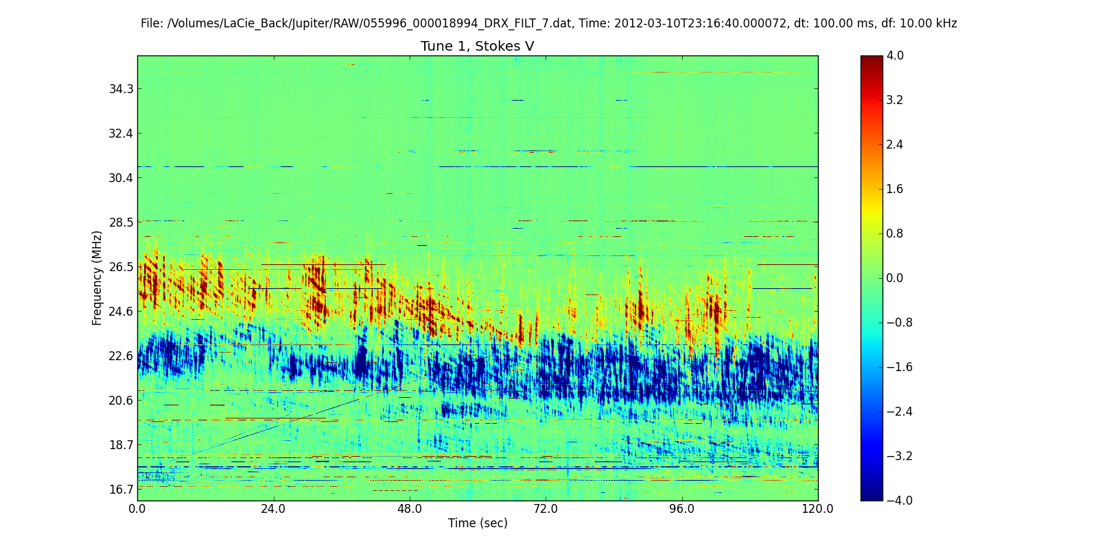
Io-C: Modulation Lanes

Slide 22
Io-C: Polarization Ratio

Slide 23
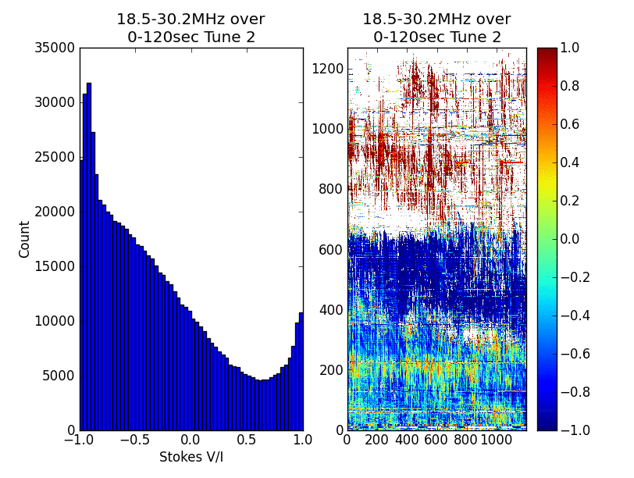
Io-C: Polarization Ratio

Slide 24
Io-B vs Io-C: Polarization Ratio
To date we have concentrated on Stokes V, linear polarization (Stokes Q and U) are next to investigate
Jupiter emission is determined to be 100 % elliptically polarized according to the literature
Measure of the circular to linear fraction from V/I(t)
Preliminary Results
  Io-B: 30 histograms analyzed -> %P_{circ} changes with time. Early times 73<%P_{circ}<80 while later times near the peak frequency have 93<%P_{circ}<100.
  Io-C: Different results for different handed emission. RHC emission is 87<%P_{circ}<93 while LHC is 93<%P_{circ}<100.
  Overall Io-B is lower circular polarization fraction than the Io-C burst studied.
NOTE: Handedness of Io-B and non-Io-A bursts are opposite to literature.
Notes:
Elevation of Io-B %P goes from 45 degrees to 35 degrees.

Slide 25
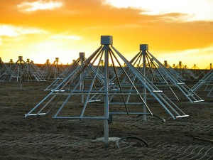
Measurements
North
Basis change to r, l
X
East
Y
Stokes (x,y basis)
Stokes (r,l basis)
Analysis follows IAU convention: X=pol 0
Y=pol 1

Slide 26
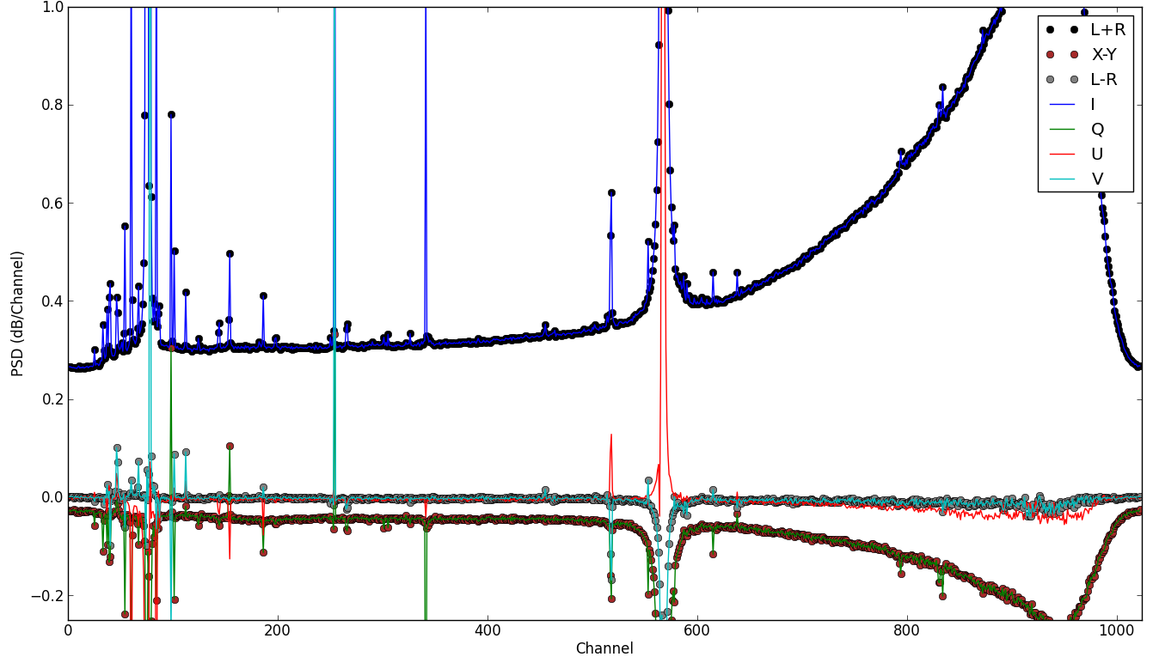
Basis Comparisons

Slide 27
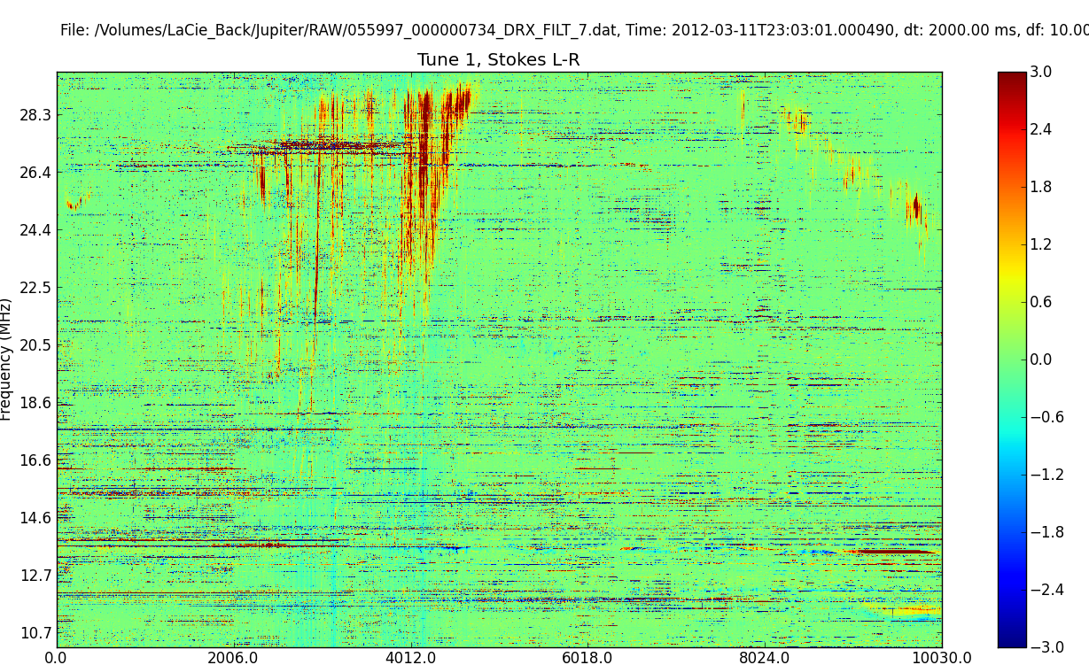
Analysis Challenges: Headroom

Slide 28
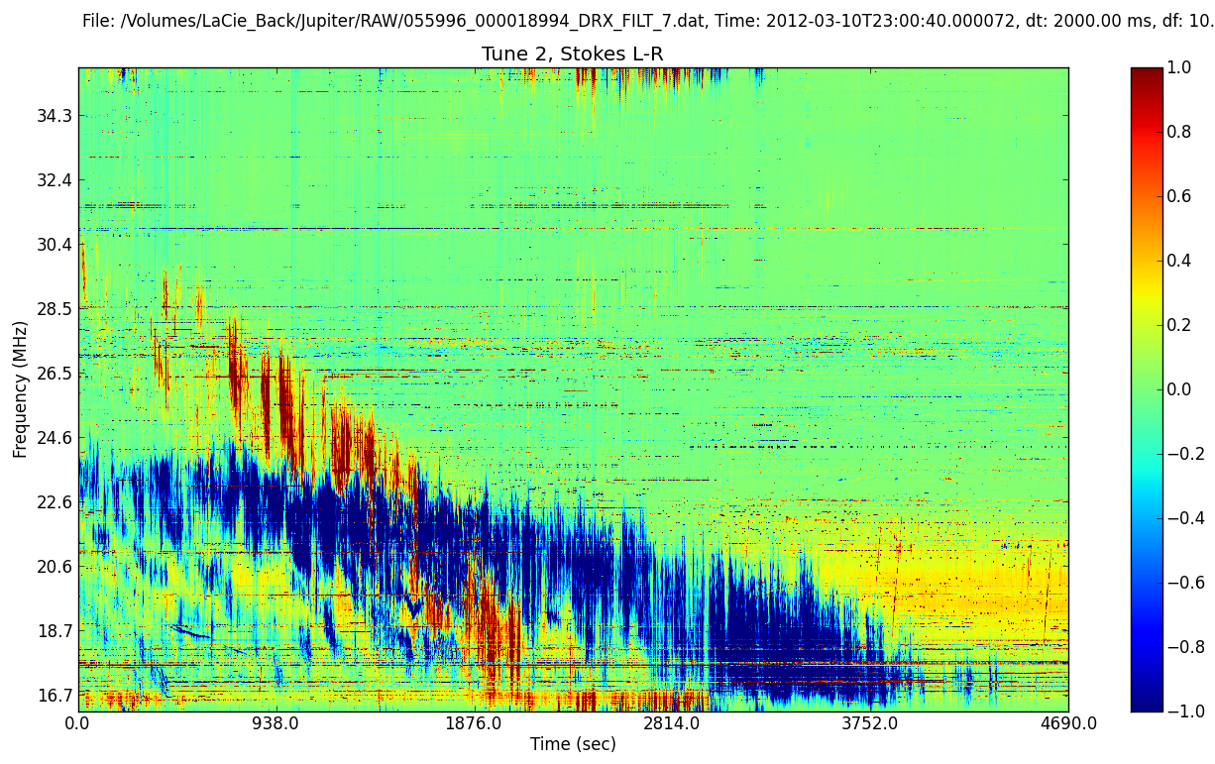
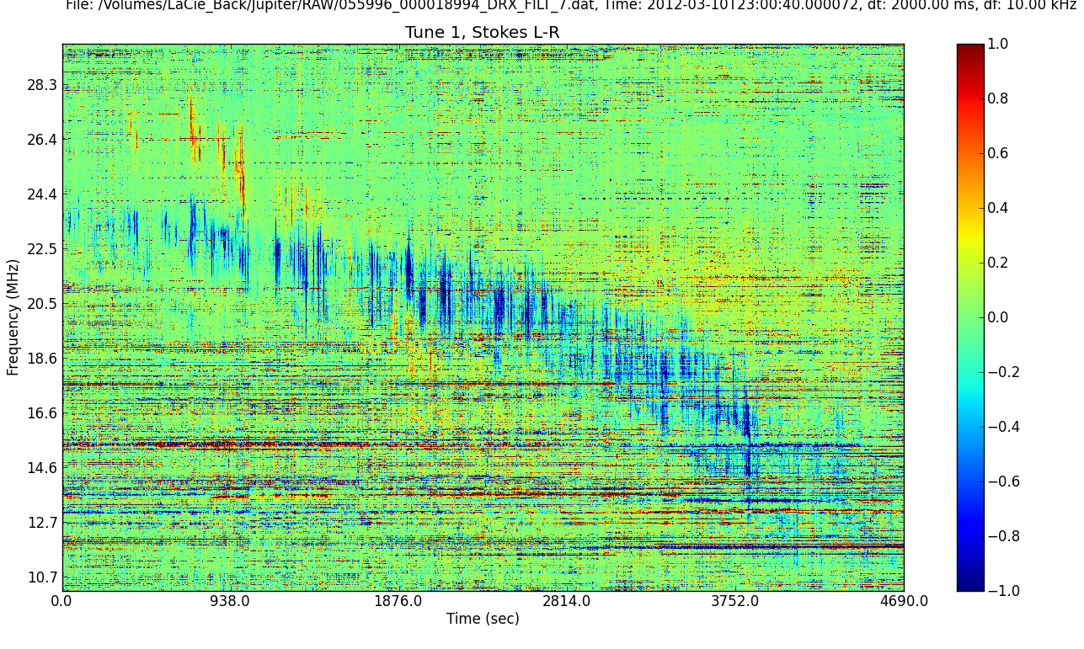
Analysis Challenges: Headroom

Slide 29
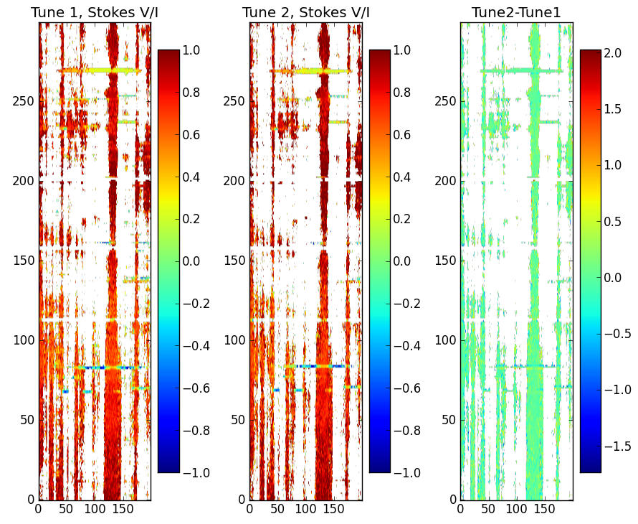
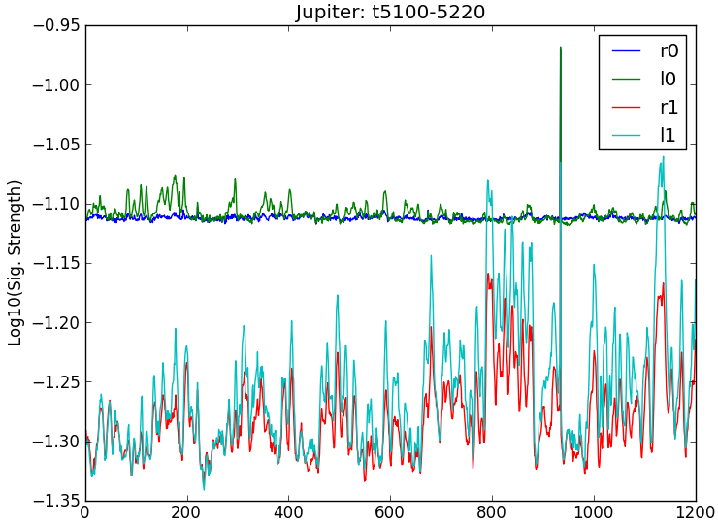
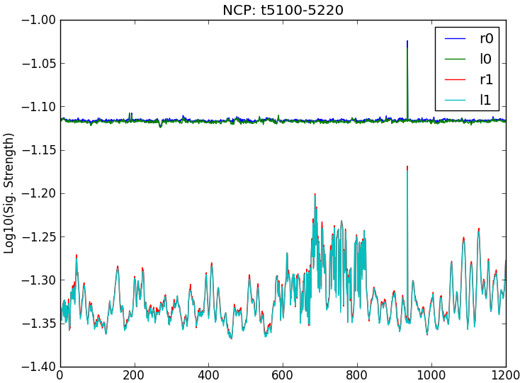
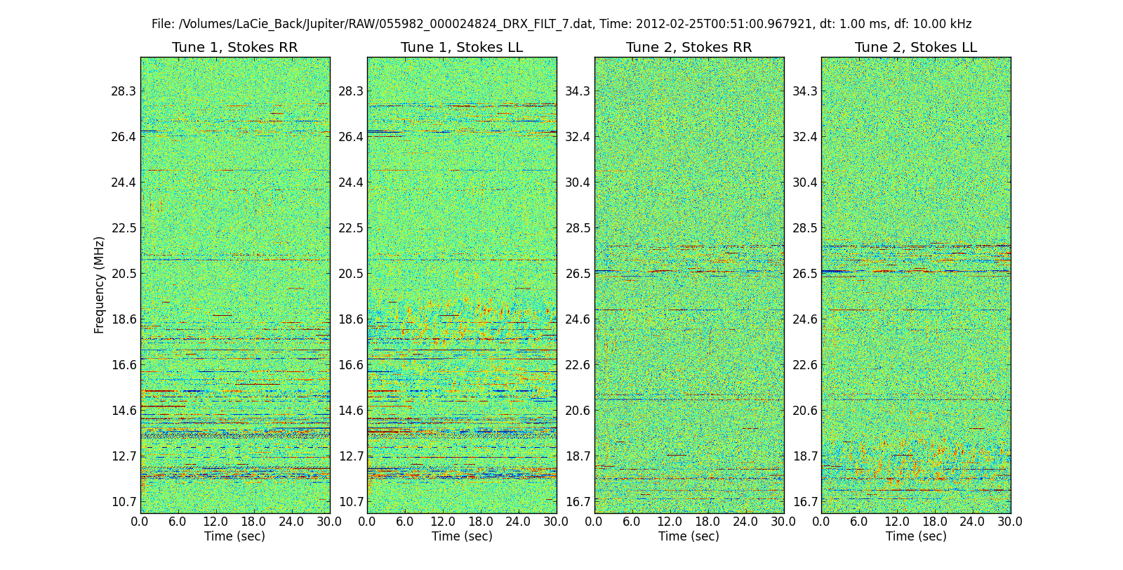

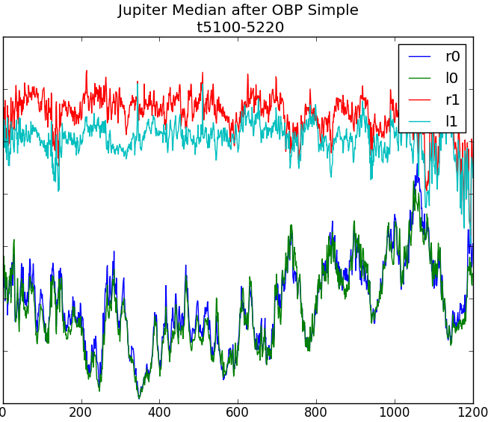
Analysis Challenges:
Time-Variable Instrument Response
Time-variable bandpass
Simple bandpass

Slide 30
Summary
Many commissioning issues impacted the data quality, only some of which could be corrected
Data volumes are very large requiring long times for processing and massive amounts of storage
Jovian decametric emission polarization properties were studied as a function of time and frequency
Fine temporal and spectral analysis of the emission yielded interesting results
Stay tuned for more results!

