Slide 1
Solar Radio Bursts with LWA-1:
DRX Observations
Stephen White
Space Vehicles Directorate
Air Force Research Laboratory

Slide 2
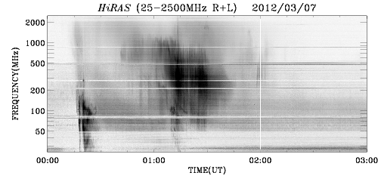
LW001: DRX data
X5 flare at 01 UT on 2012 March 7

Slide 3
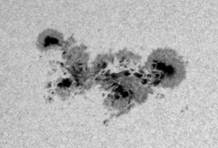

Slide 4
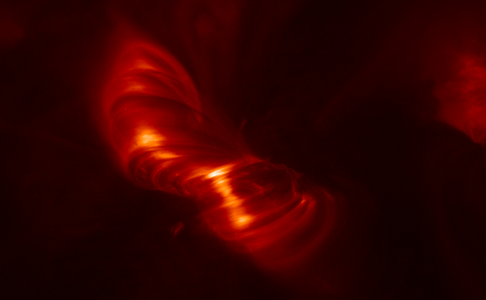
Post-flare loops: site of energy release(?) Locus of radio Type IV burst?

Slide 5
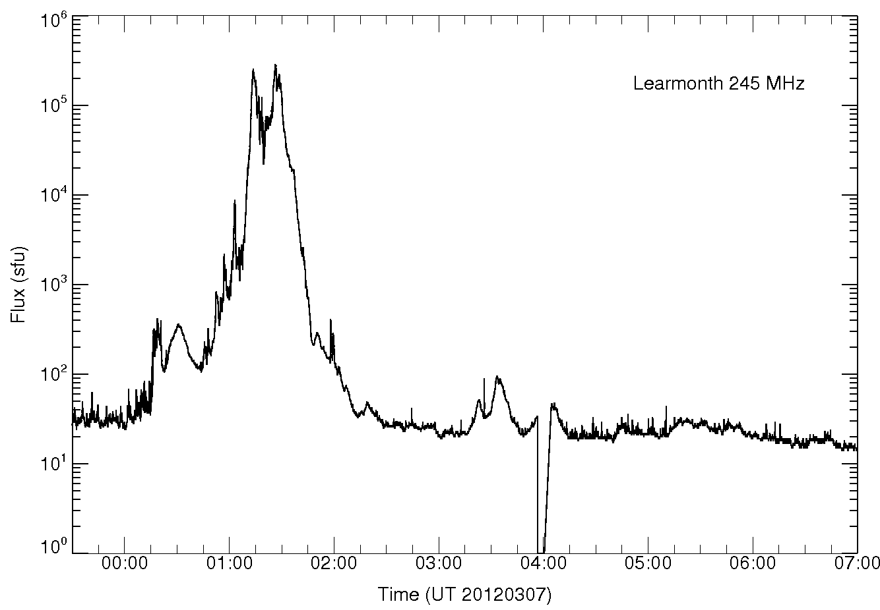
Bright radio emission

Slide 6
LW001
DRX setup:
Beam 1 on Sun: filter 5, 10-15 & 15-20 MHz
Beam 2 on Sun: filter 7, 15-34 & 34-52 MHz
Beam 3 off Sun: filter 7, 15-34 & 34-52 MHz
Beam 4 on Sun: filter 7, 52-70 & 70-88 MHz
3 × 2.2 TB + 0.4 TB (need 3 TB drives)
Still learning …. but access time with LSL is fine

Slide 7
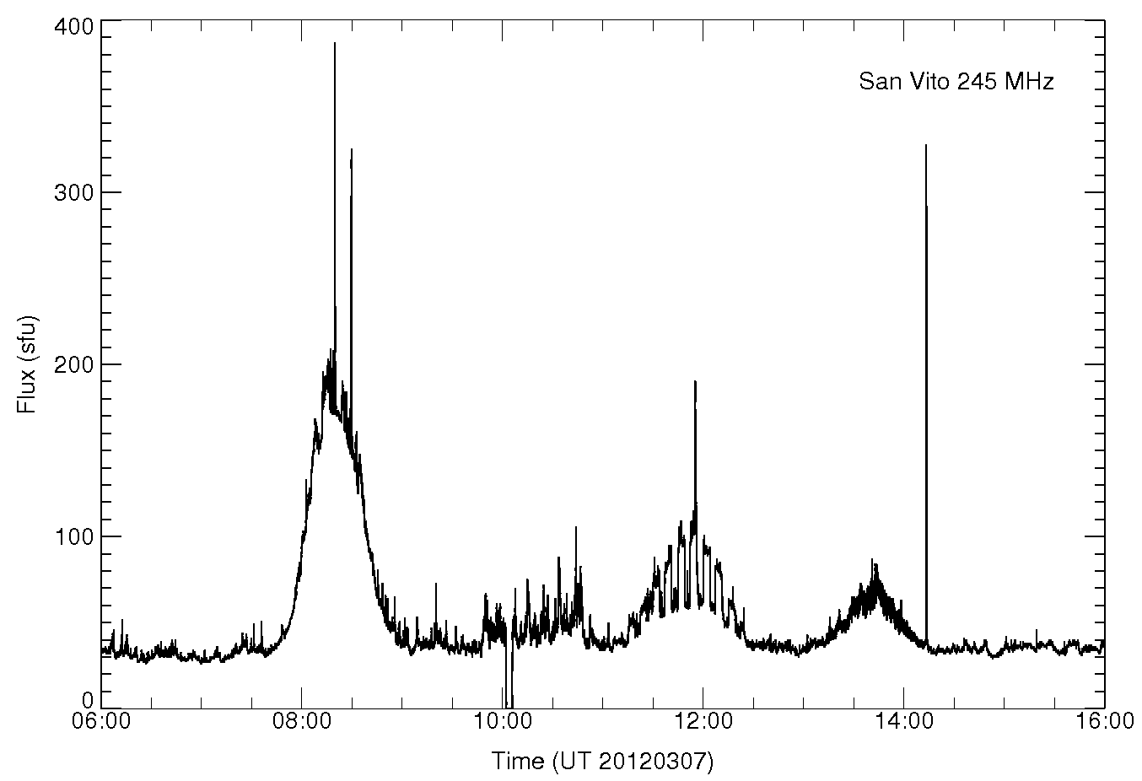
245 MHz light curve into LWA morning

Slide 8
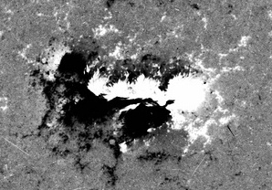
Magnetic field distribution

Slide 9
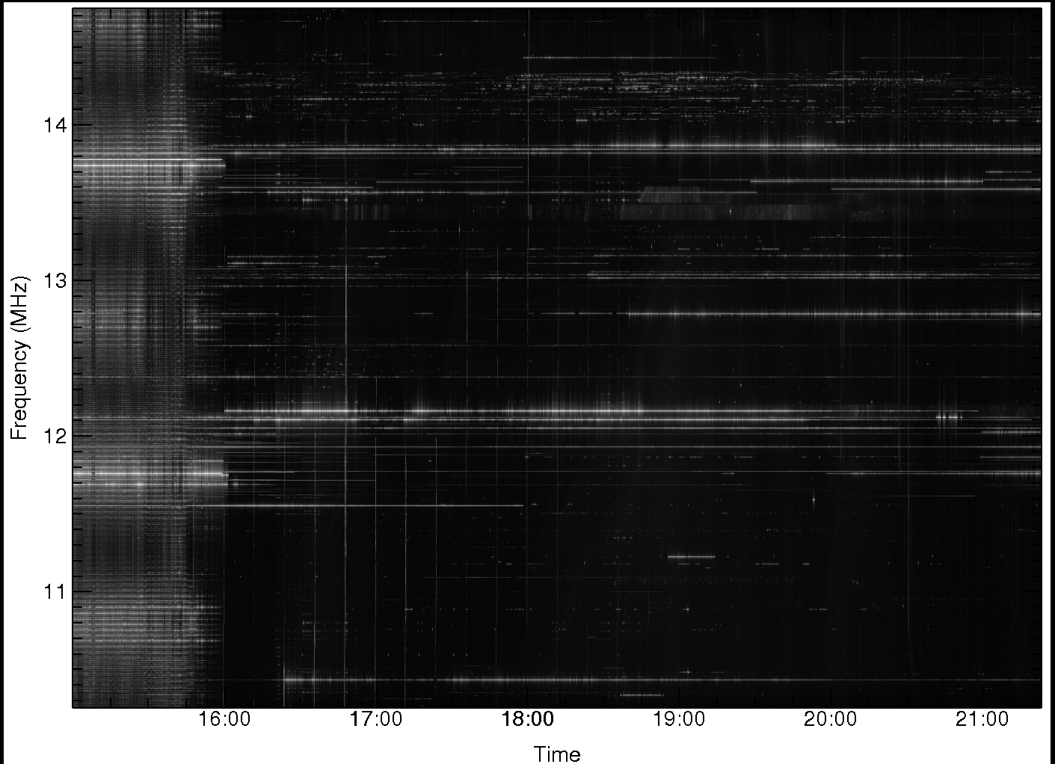
Summary plot: 10-15 MHz

Slide 10
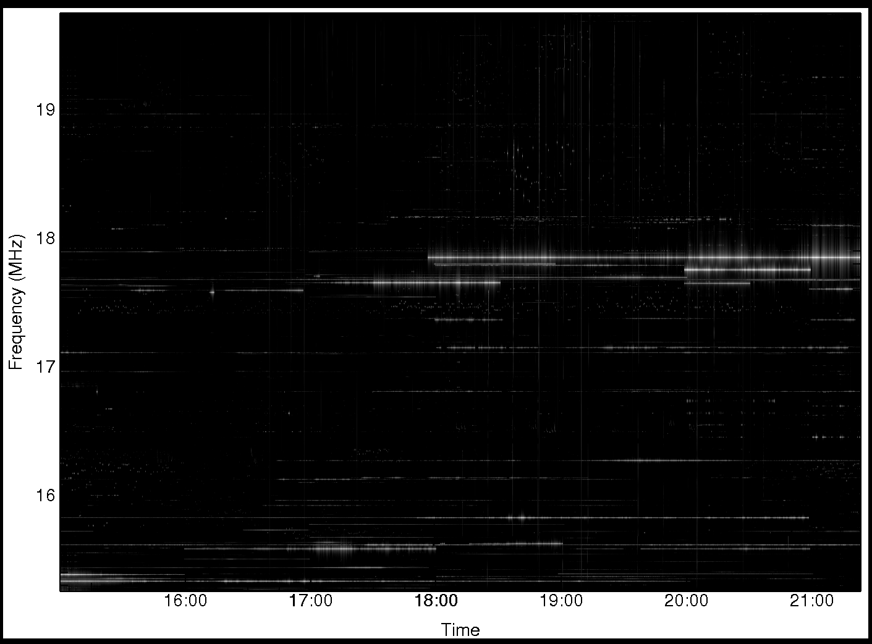
Summary plot: 15-20 MHz

Slide 11
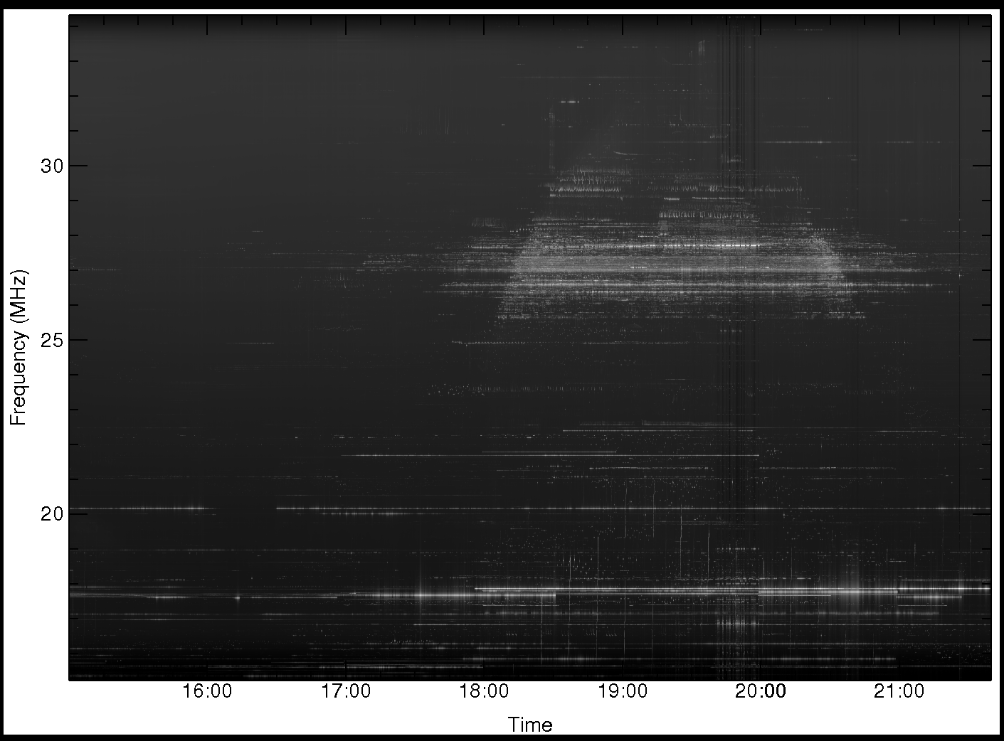
Summary plot: 15-34 MHz 45° above Sun

Slide 12
Summary plot: 15-34 MHz on Sun

Slide 13
Summary plot: 34-52 MHz off Sun

Slide 14
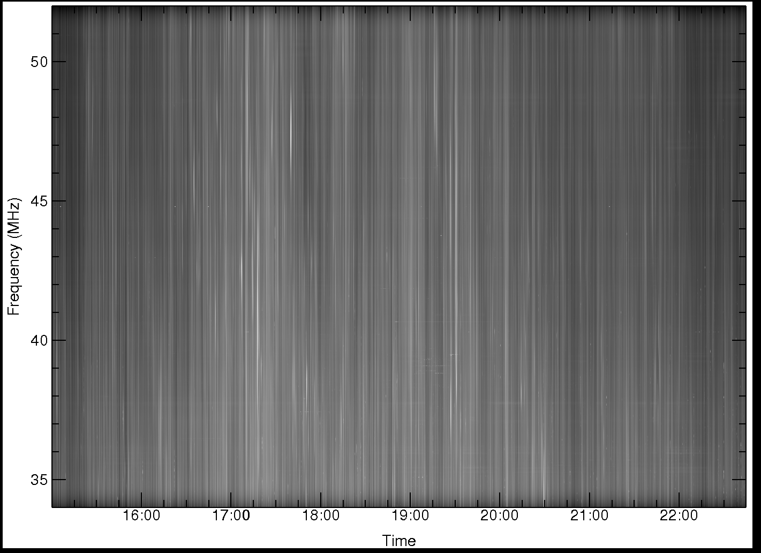
Summary plot: 34-52 MHz on Sun

Slide 15
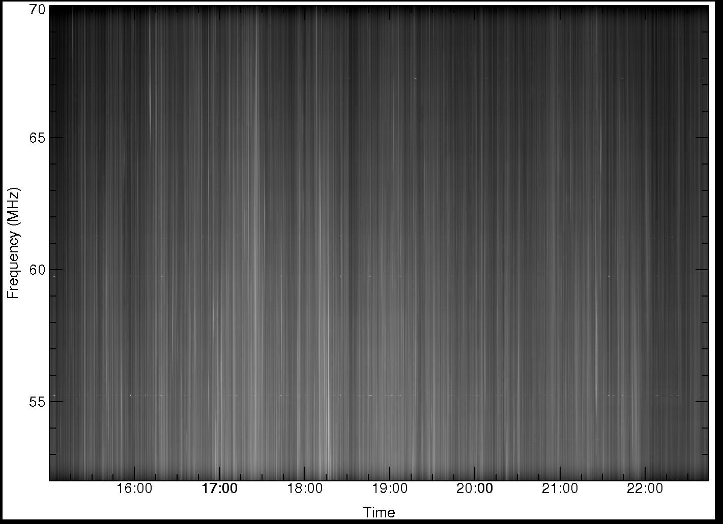
Summary plot: 52-70 MHz

Slide 16
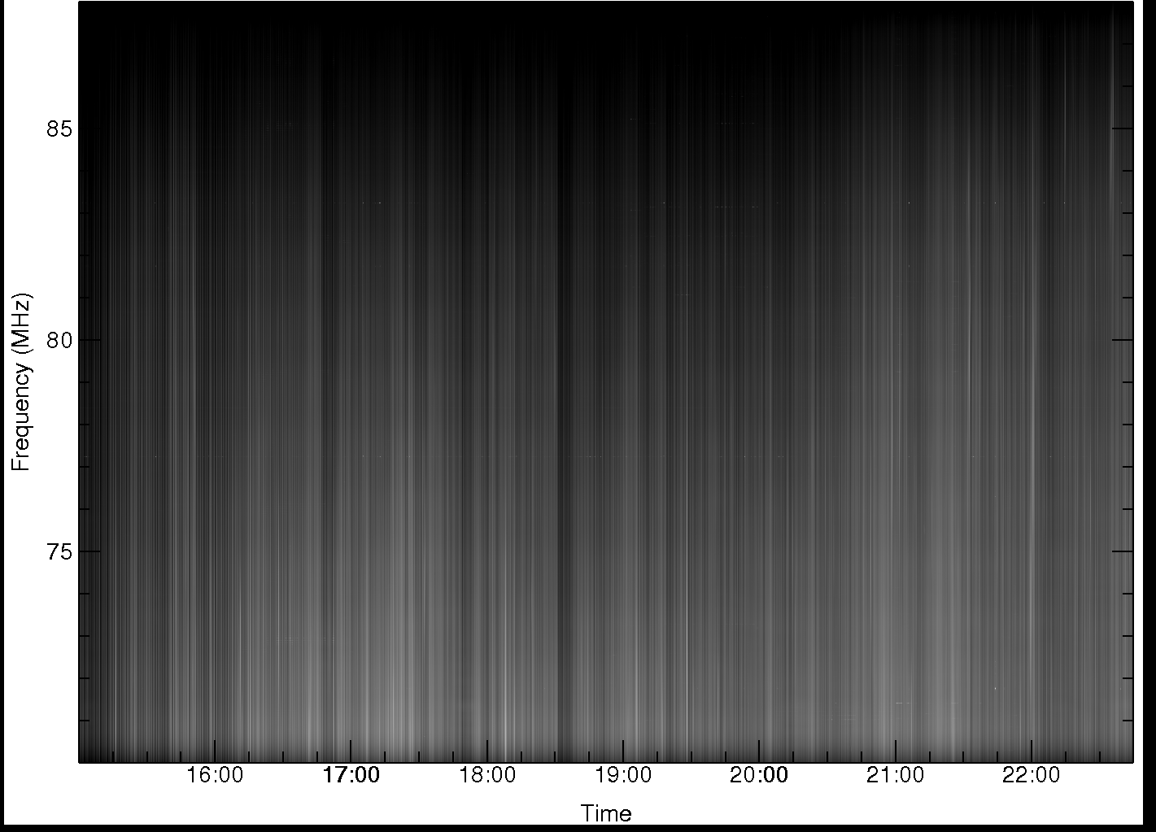
Summary plot: 70-88 MHz

Slide 17
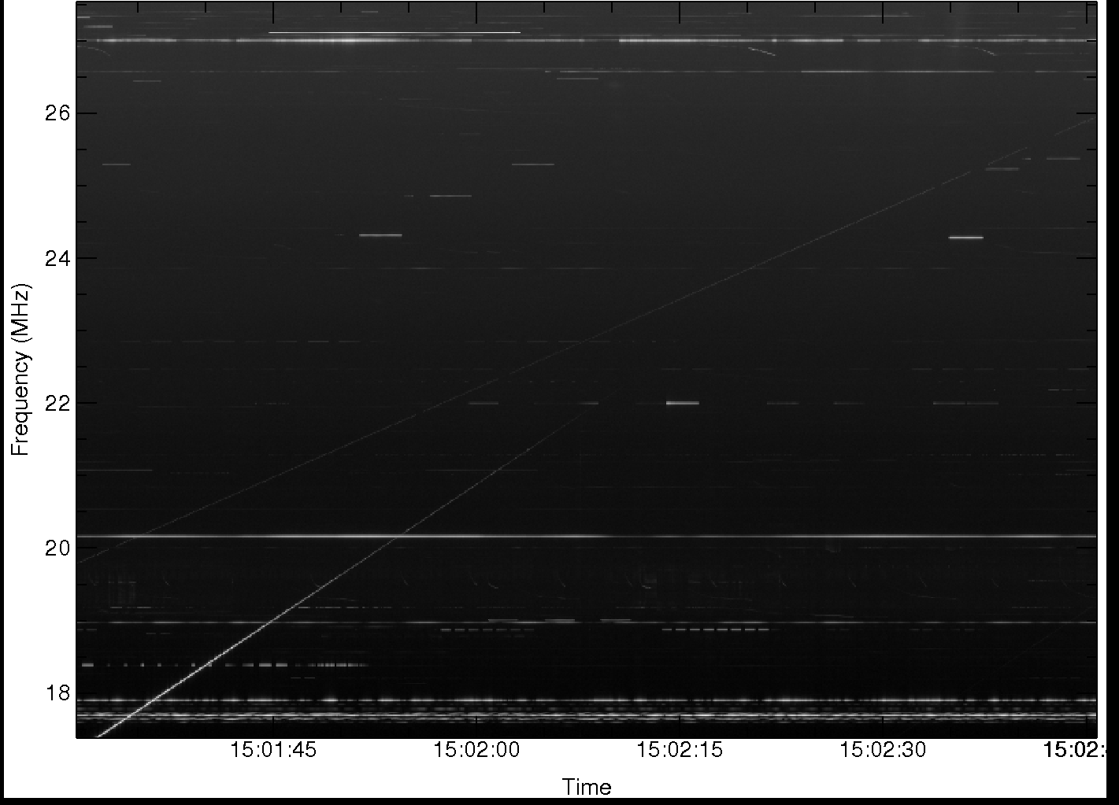
RFI at 15 UT off Sun

Slide 18
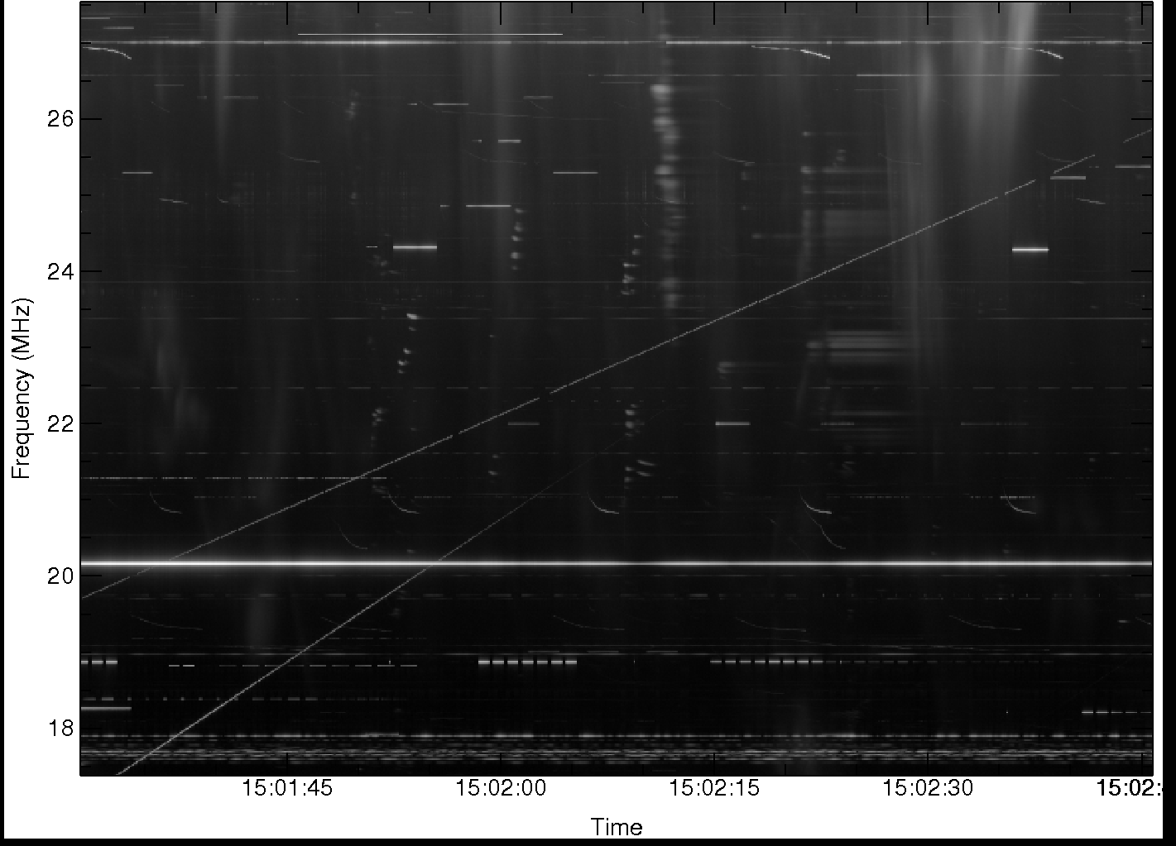
RFI at low elevation (solar beam)

Slide 19
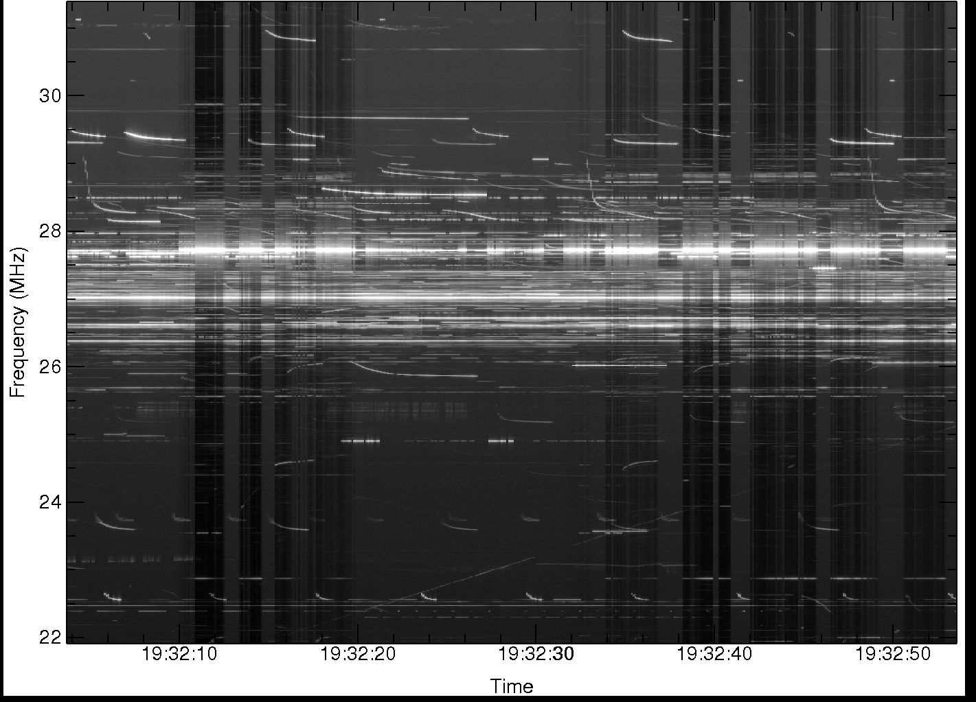
RFI at 20 UT off Sun

Slide 20
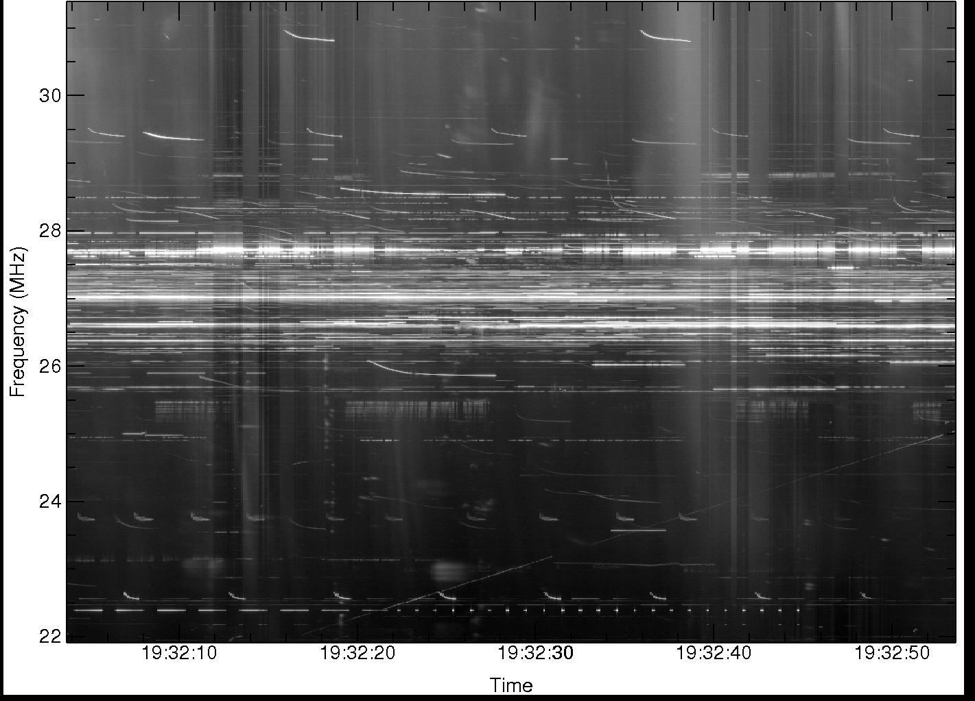
RFI on Sun at local noon

Slide 21
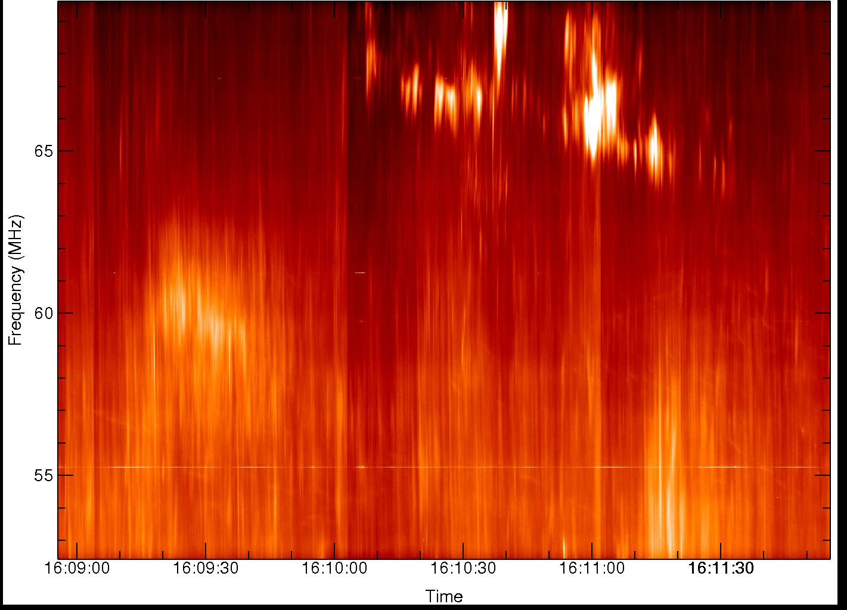
Typical noise storm feature: Type I bursts

Slide 22
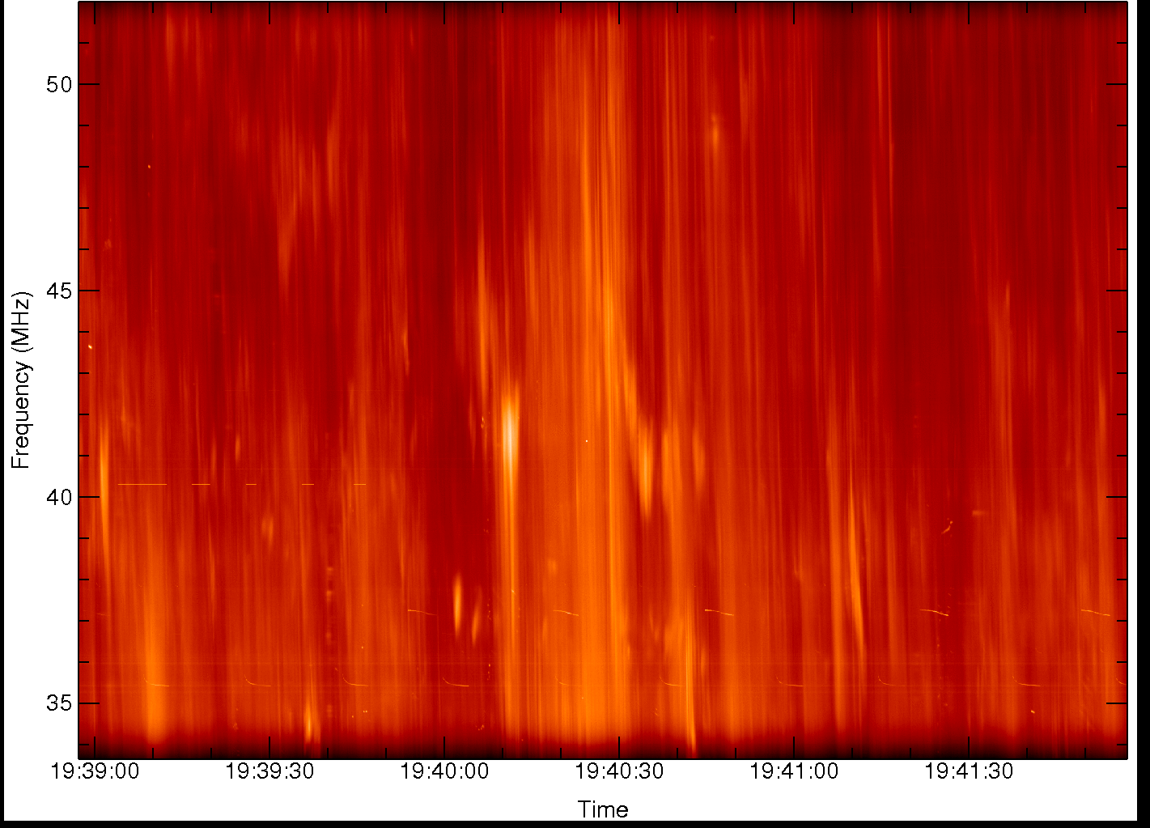
Low frequency emission: 34-52 MHz

Slide 23
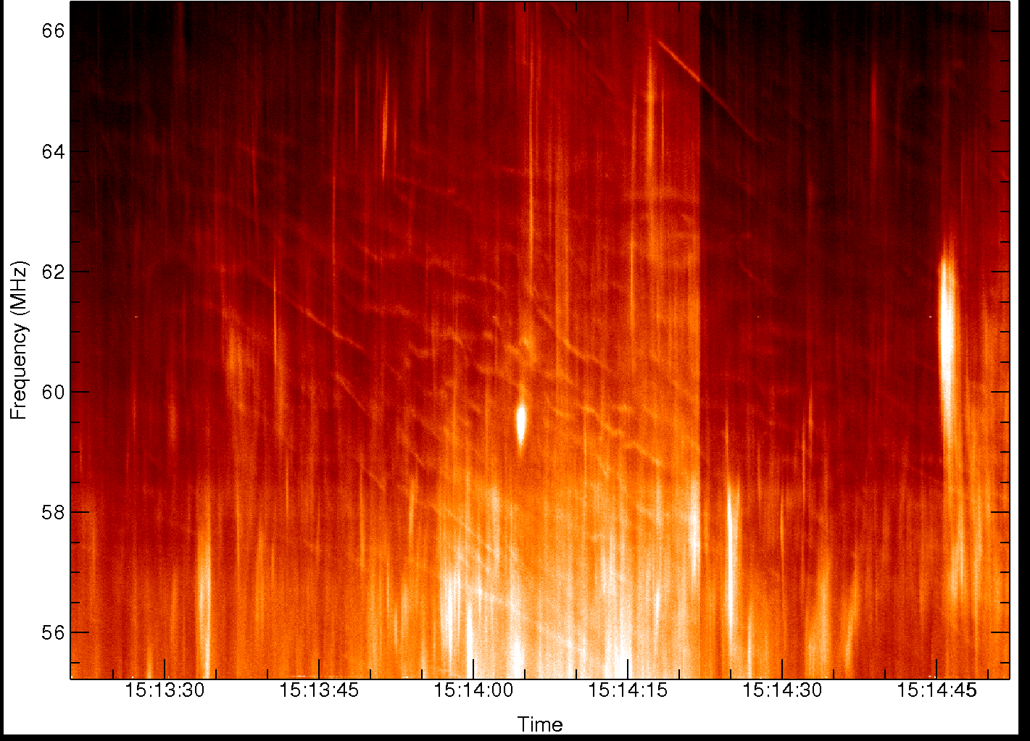
Unexpected fine structure above 60 MHz

Slide 24
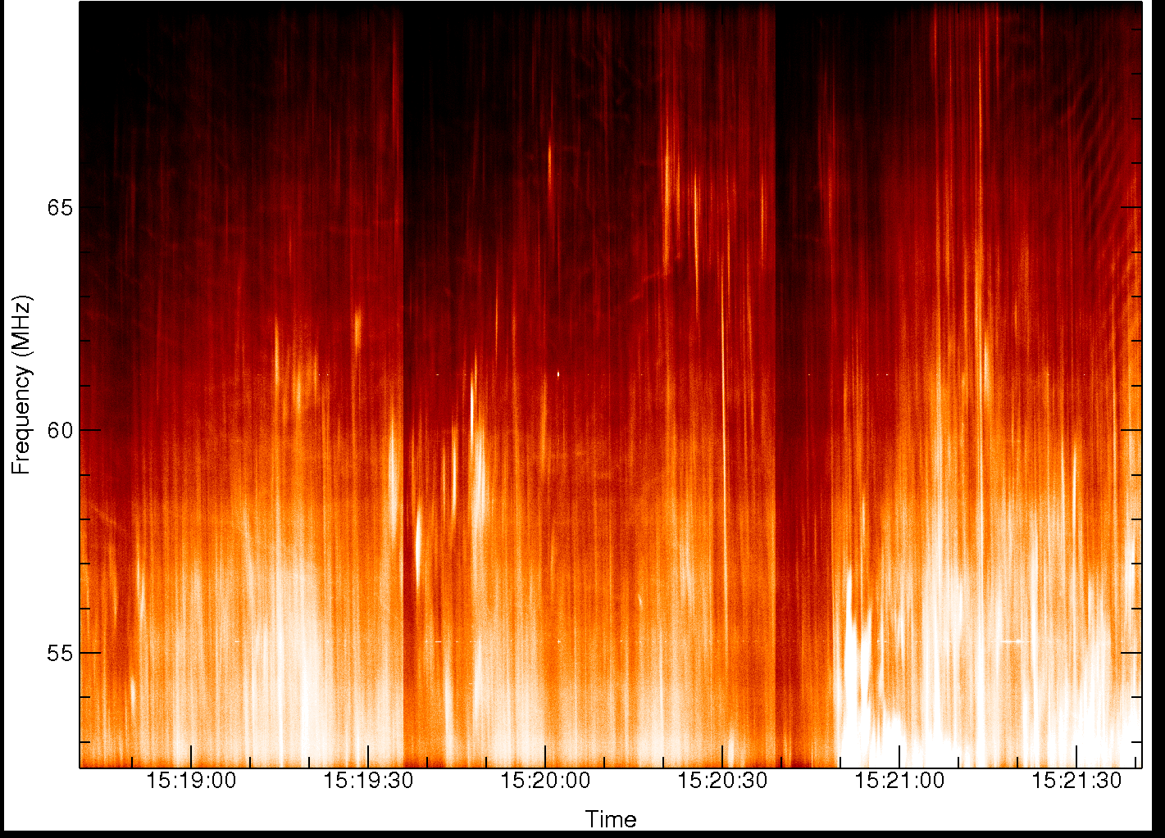
“Zebra” patterns more common in flares

Slide 25
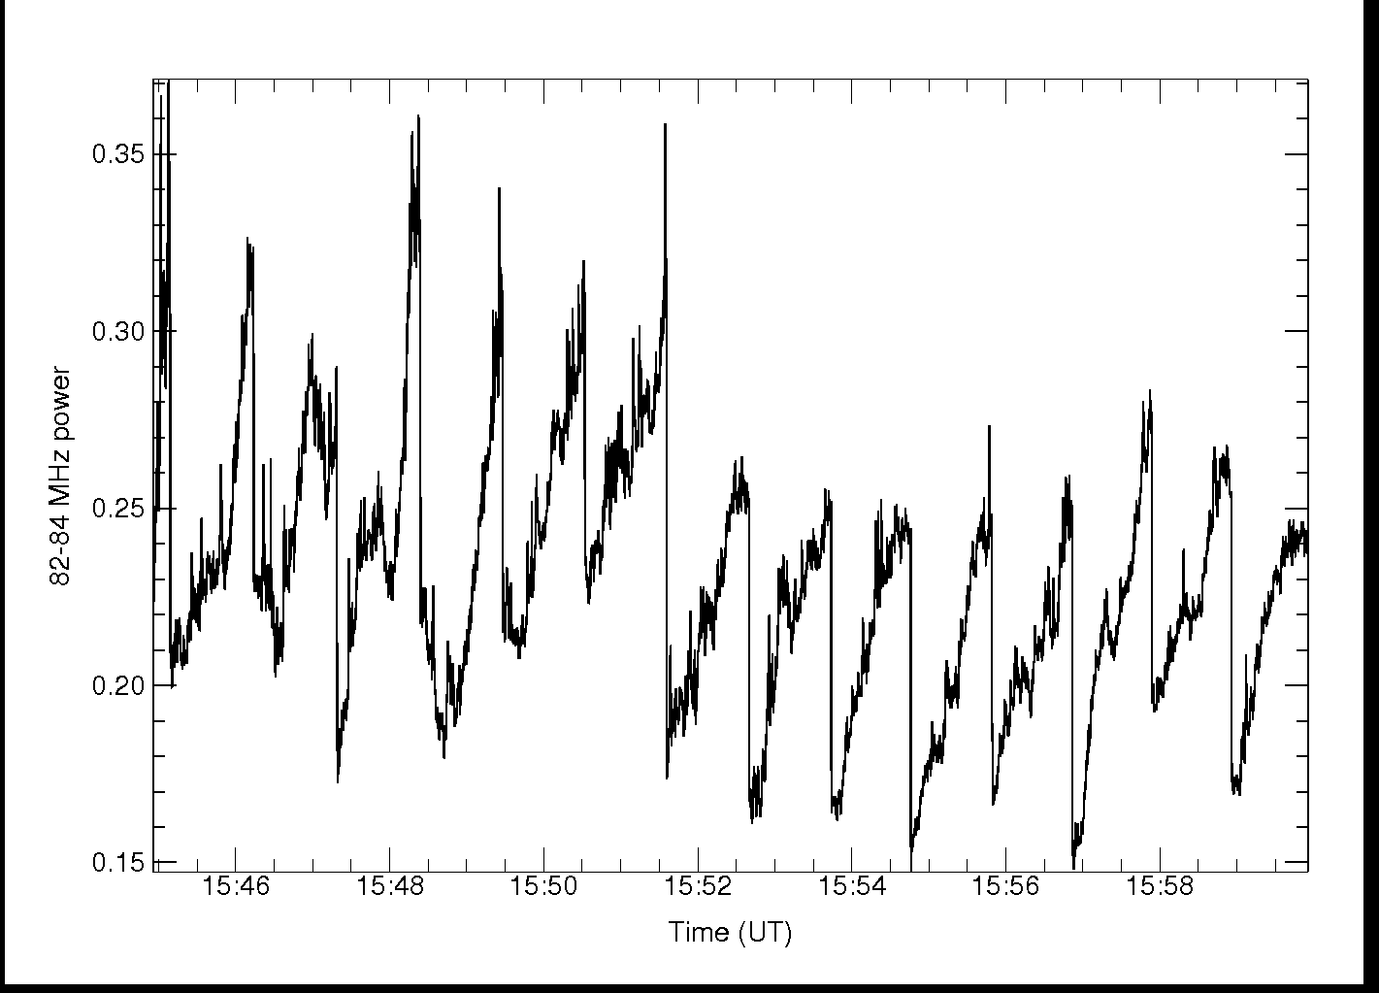
Issues at high frequencies: pointing?

Slide 26
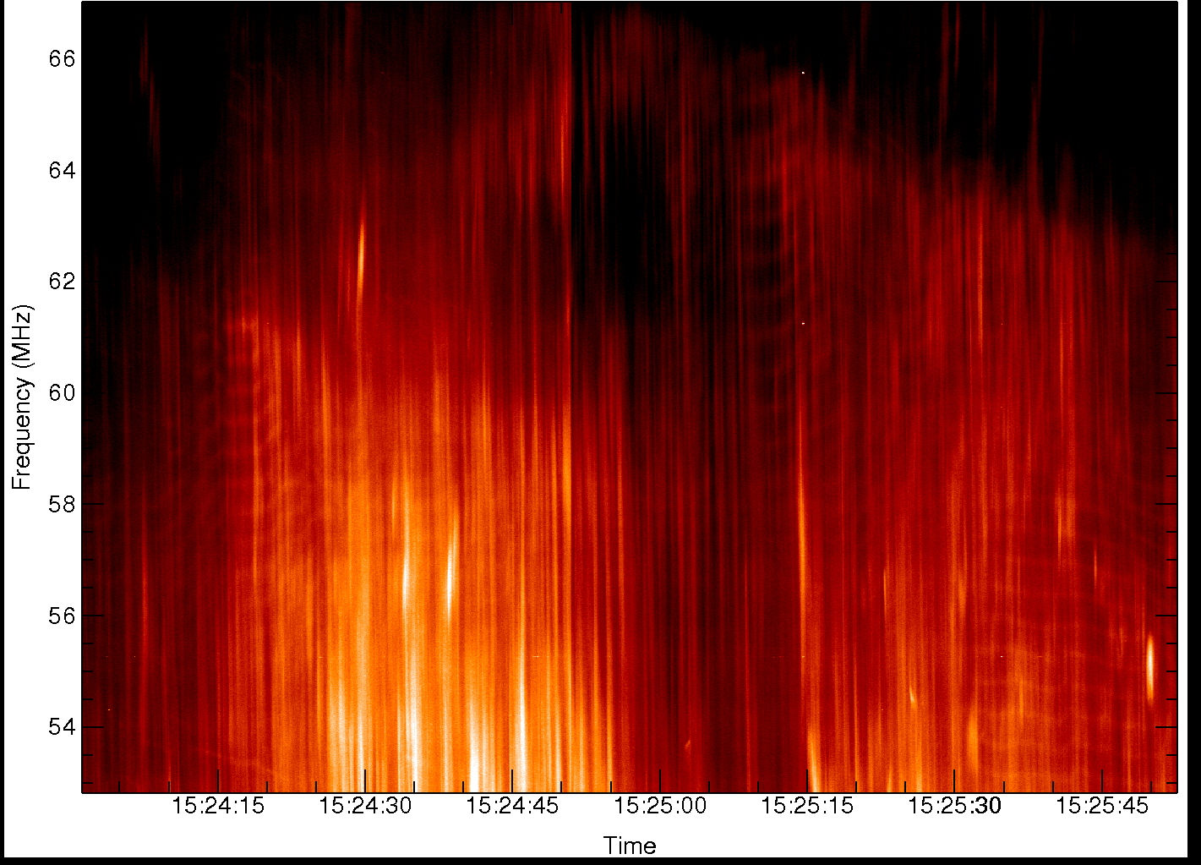
Wrigglers and zebra alternating

Slide 27
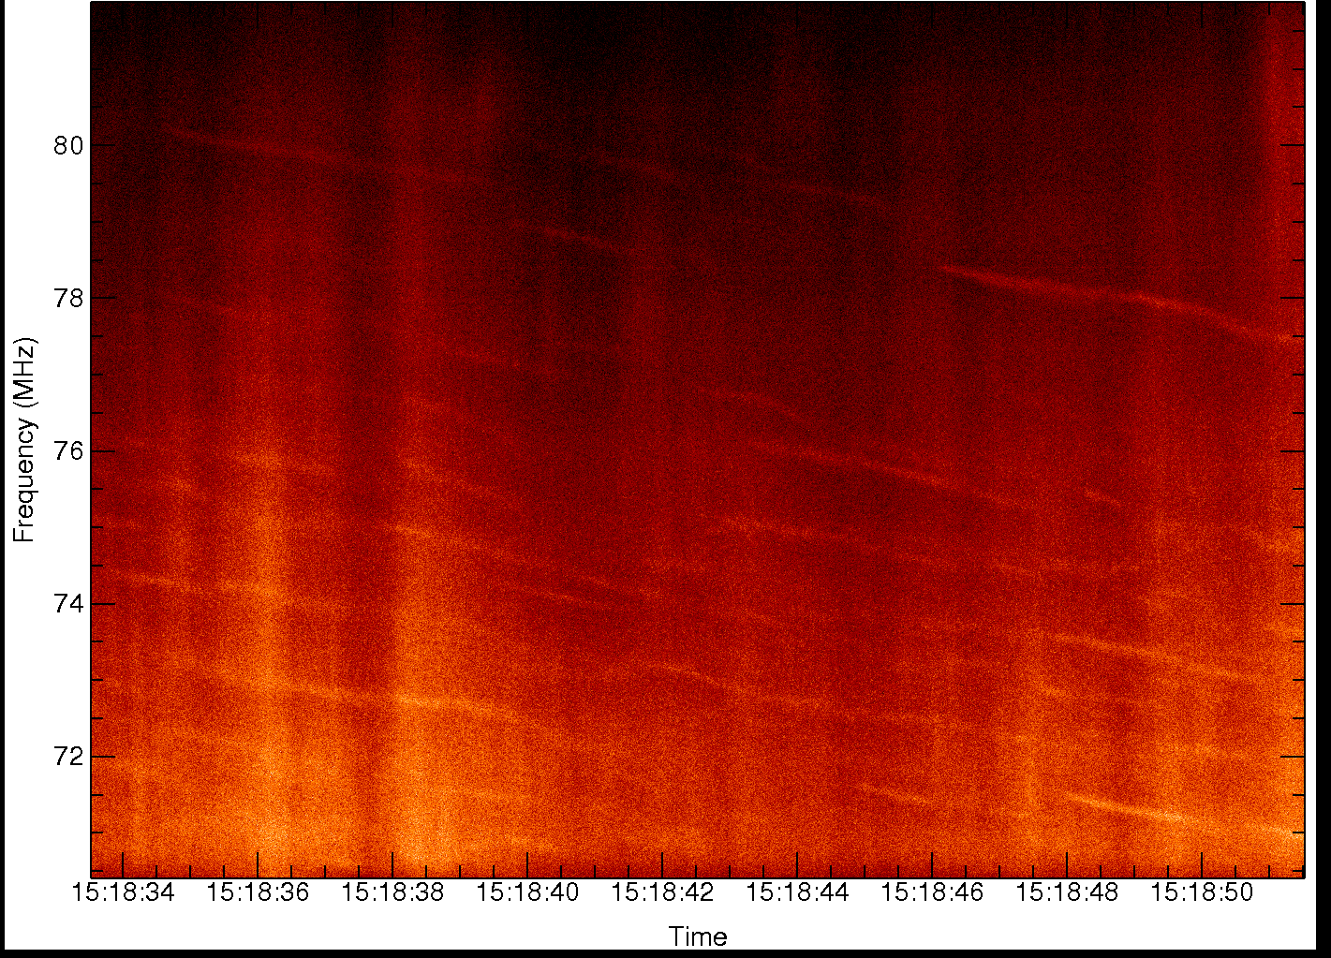
“Wrigglers” at 10 millisecond resolution

Slide 28
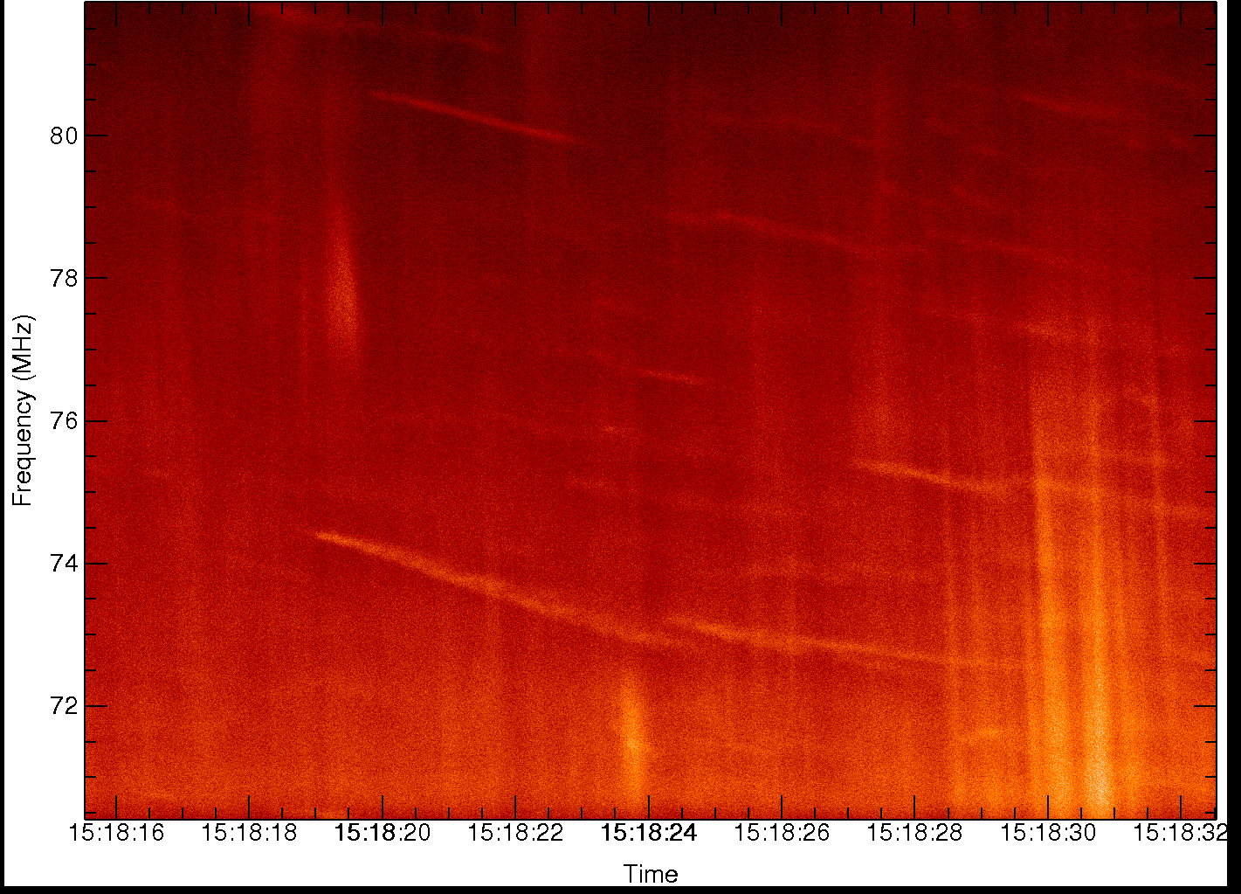
Wrigglers, Type I, broadband modulation

Slide 29
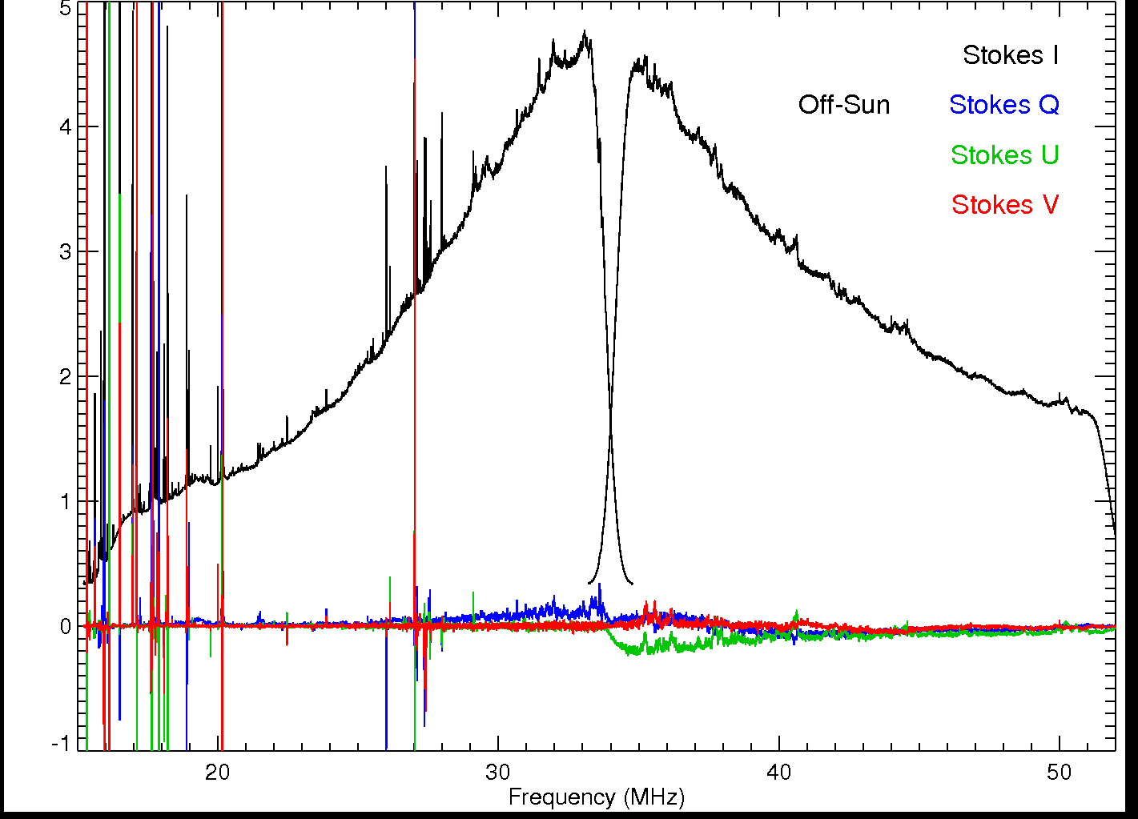
Polarization properties: off Sun

Slide 30
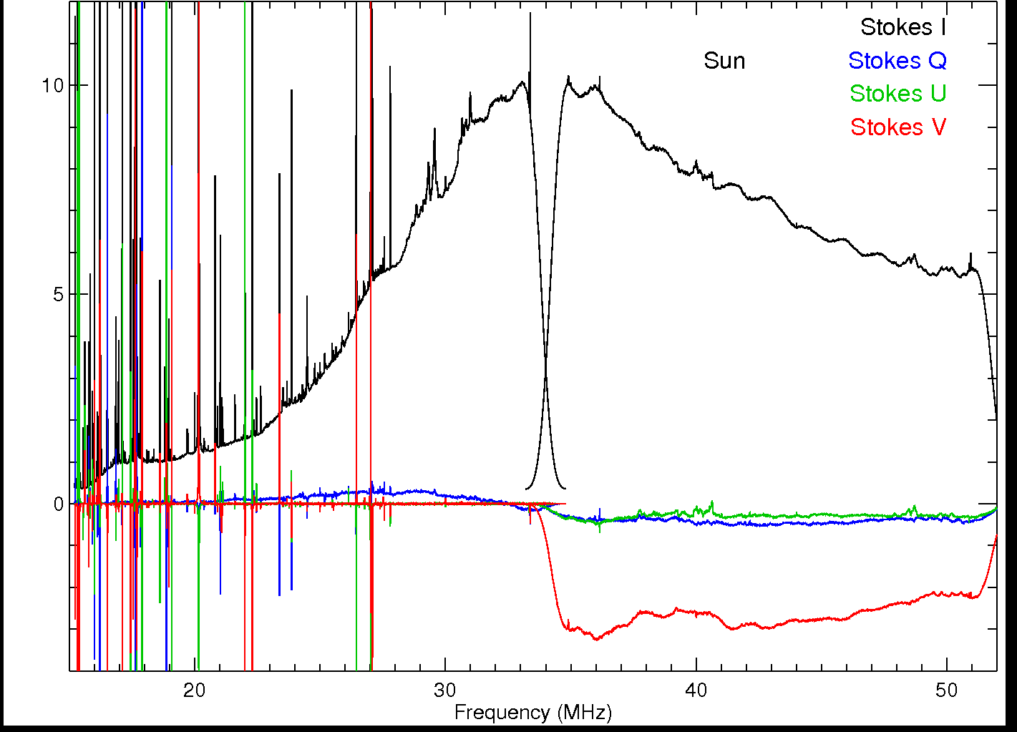
Polarization properties: on Sun

Slide 31
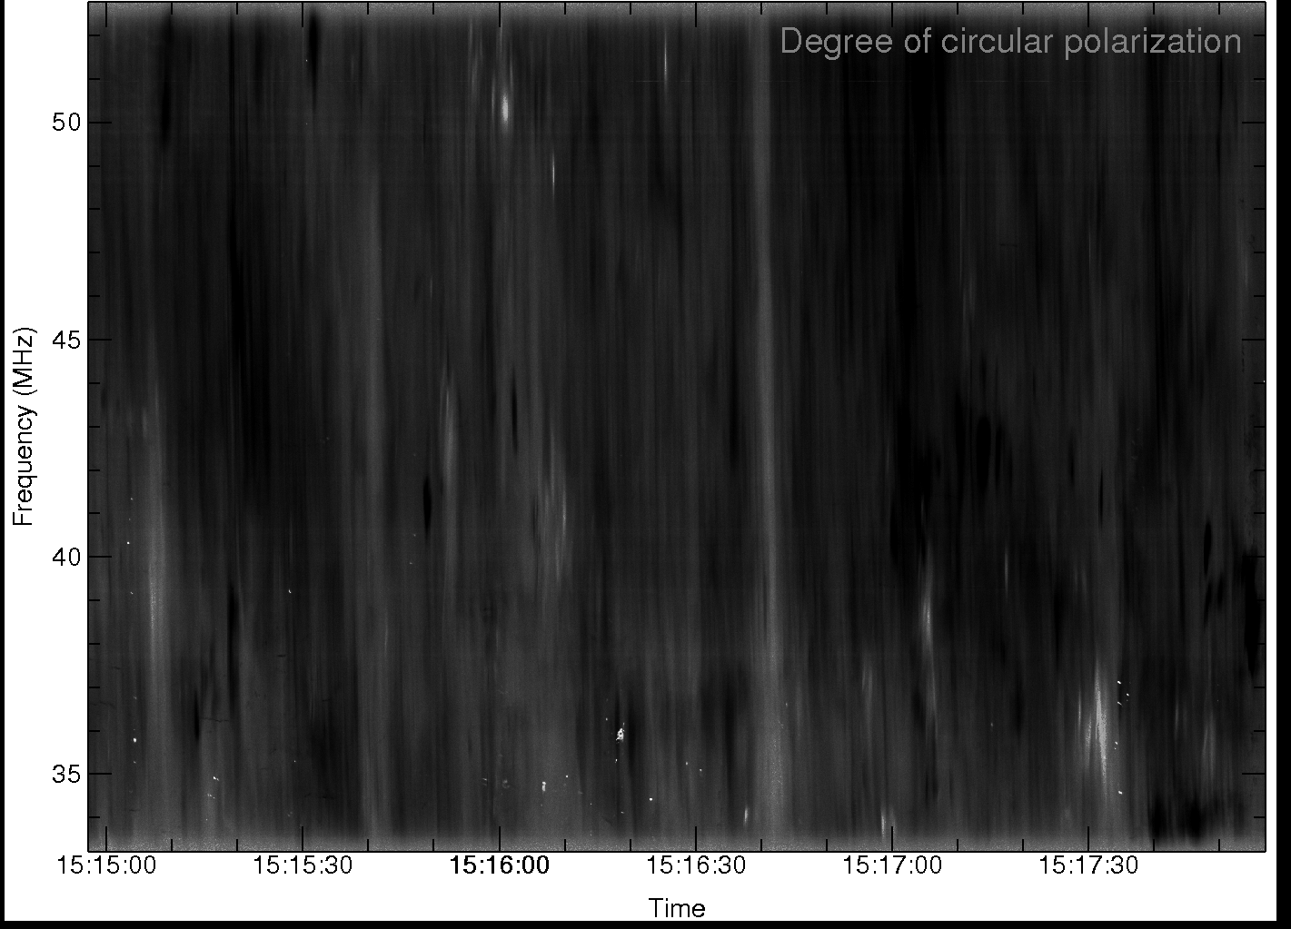
Circular polarization spectrum

Slide 32
Notes:
This slide summarizes the results of a quick survey of the 1999 Type II bursts on the CRL/HIRAISO web site for which LASCO data are available.

Slide 33
Science with LWA-1 TBN data
TBN data provide basically rapid sampling of the waveform at a fixed frequency
Big push by the Sydney group (Cairns, Robinson, Li) to interpret low-frequency plasma emission with “stochastic growth theory” (SGT): electron beams are not uniformly saturated but are dominated by density fluctuations in the medium, results in marginally unstable beams with very bursty emission.
SGT predicts a log-normal distribution of intensities when averaged, power-law at high time resolution
Complicated for coronal work by large sources and multi-path propagation
Notes:
This slide summarizes the results of a quick survey of the 1999 Type II bursts on the CRL/HIRAISO web site for which LASCO data are available.

Slide 34
Science with LWA-1 TBW data
TBW data provide snapshot spectra (60 msec) every minute: basically “luck” as to which portion of a burst you get
What they do is confirm spectral structure that isn’t always “believable” in dynamic spectra
Existing data already indicate interesting structure: need to interpret in terms of coronal inhomogeneity and electron beam properties.
Notes:
This slide summarizes the results of a quick survey of the 1999 Type II bursts on the CRL/HIRAISO web site for which LASCO data are available.

Slide 35
The
Notes:
This slide summarizes the results of a quick survey of the 1999 Type II bursts on the CRL/HIRAISO web site for which LASCO data are available.

