Slide 1
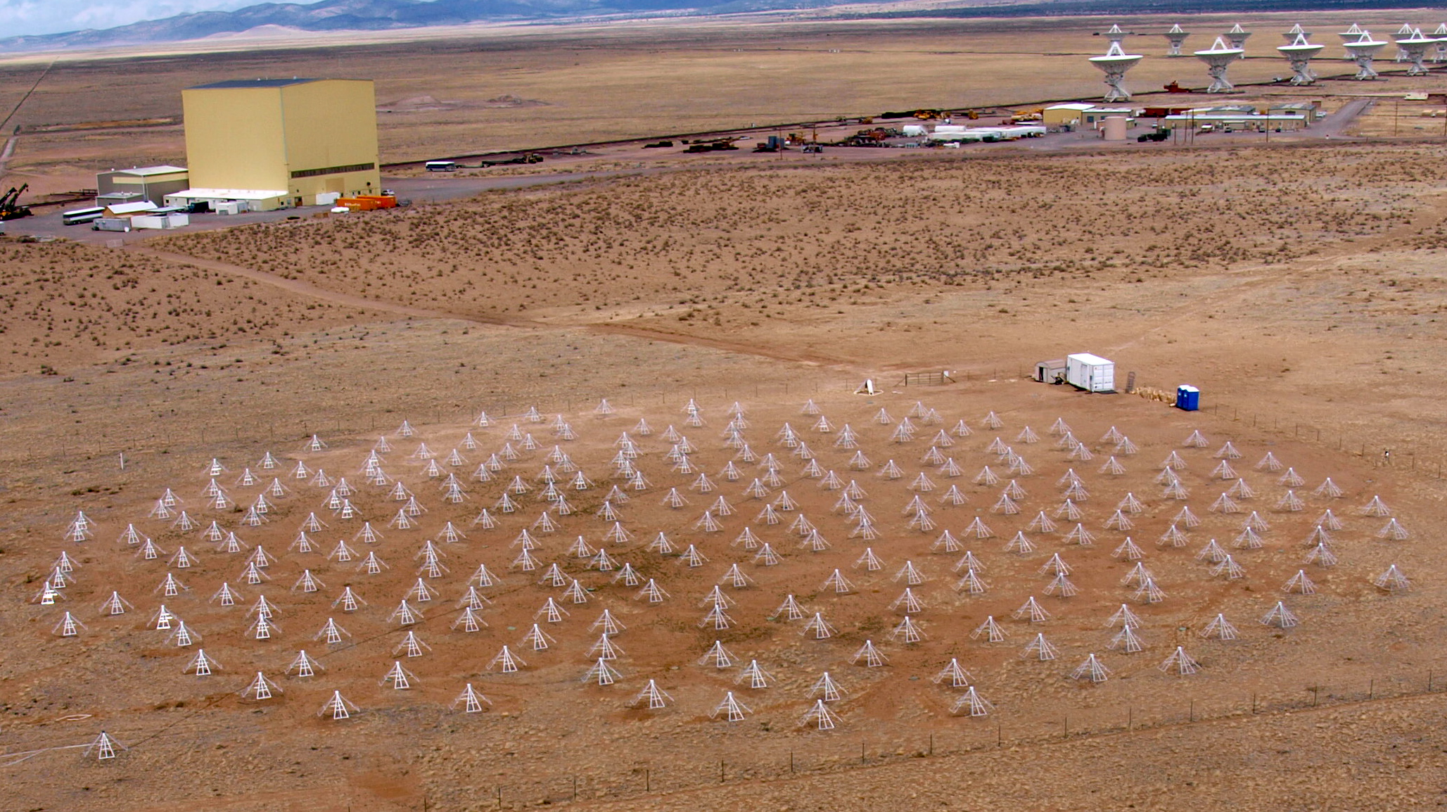
LWA Future Plans
Greg Taylor (UNM ) on behalf of the LWA Project

Slide 2
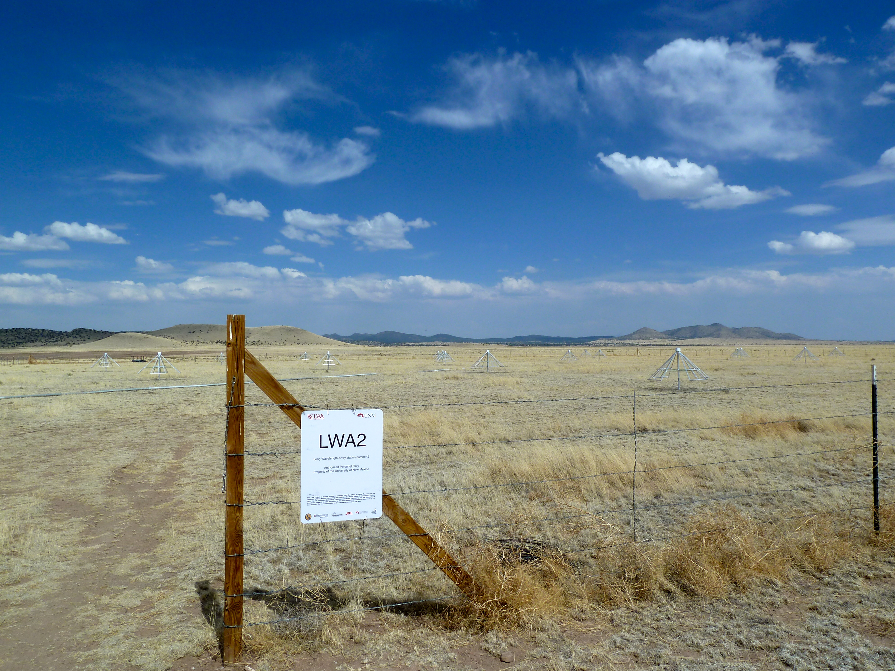
North Arm Site
20 Dipoles installed across 100m diameter
16 dual polarization cabled up
TBN/TBW capability demonstrated
Notes:
power 26455 communications 27180 data recording 50000 data collection 10011 spares 20939 misc 16000 travel 6192 shipping 6282 staff 432000

Slide 3
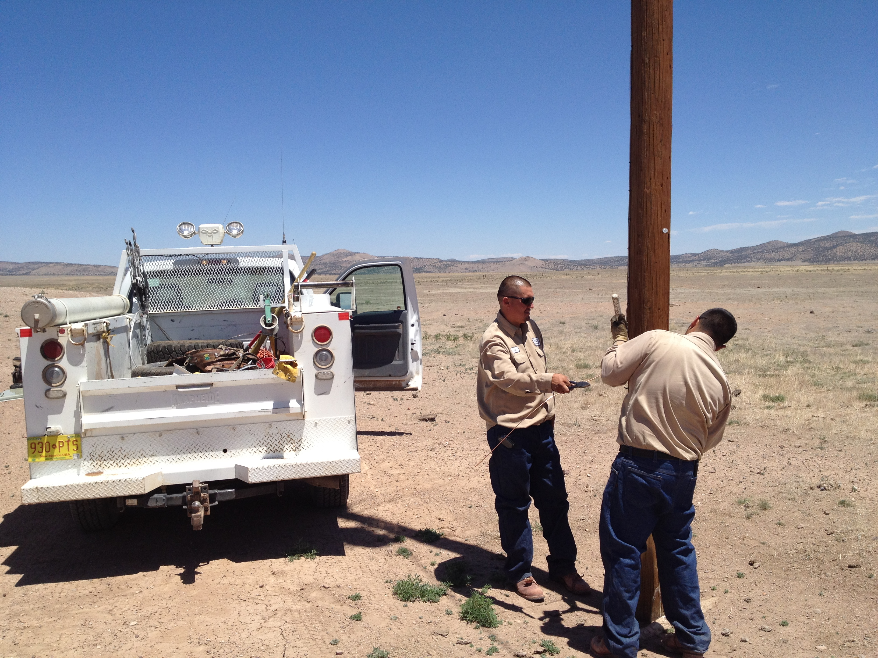
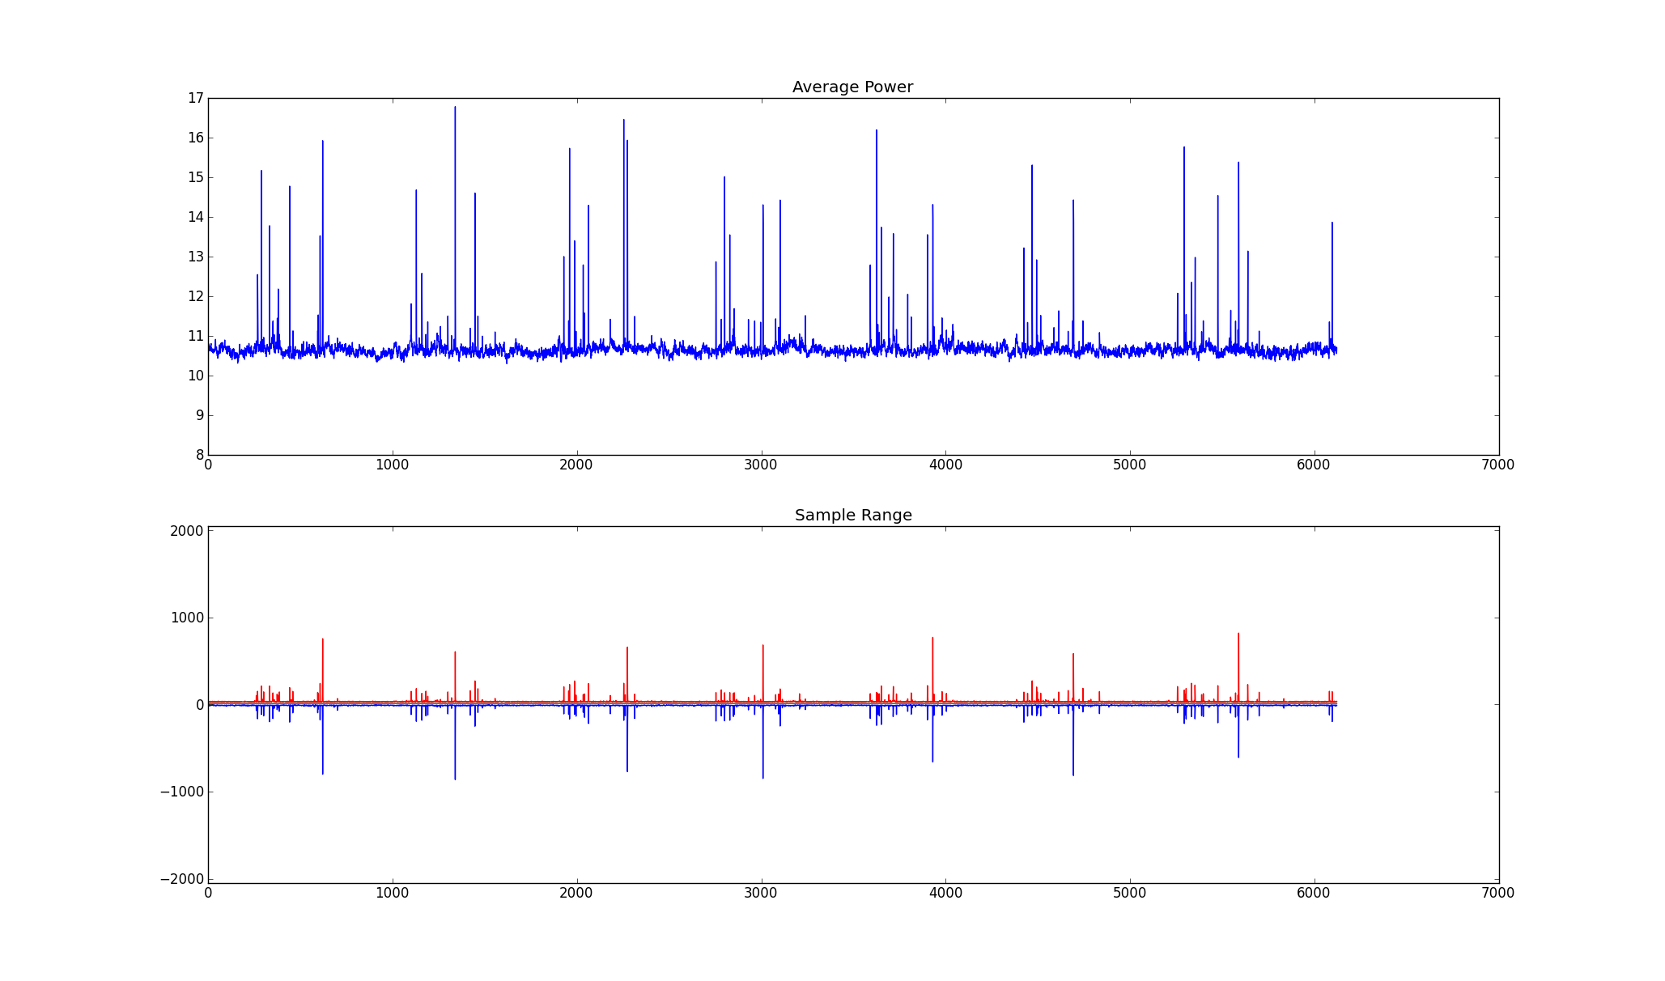
North Arm Site
16 dipole TBW
Notes:
JJ and Ernest working on LWANA power lines

Slide 4
LWA Projects

Slide 5
Pending Support
NSF/AAG Proposal (Hot Jupiters)
Undergraduate student support
Software (Jayce Dowell)
NSF/EARS Proposal on Spectrum Measurement
AFRL Proposals
others?

Slide 6
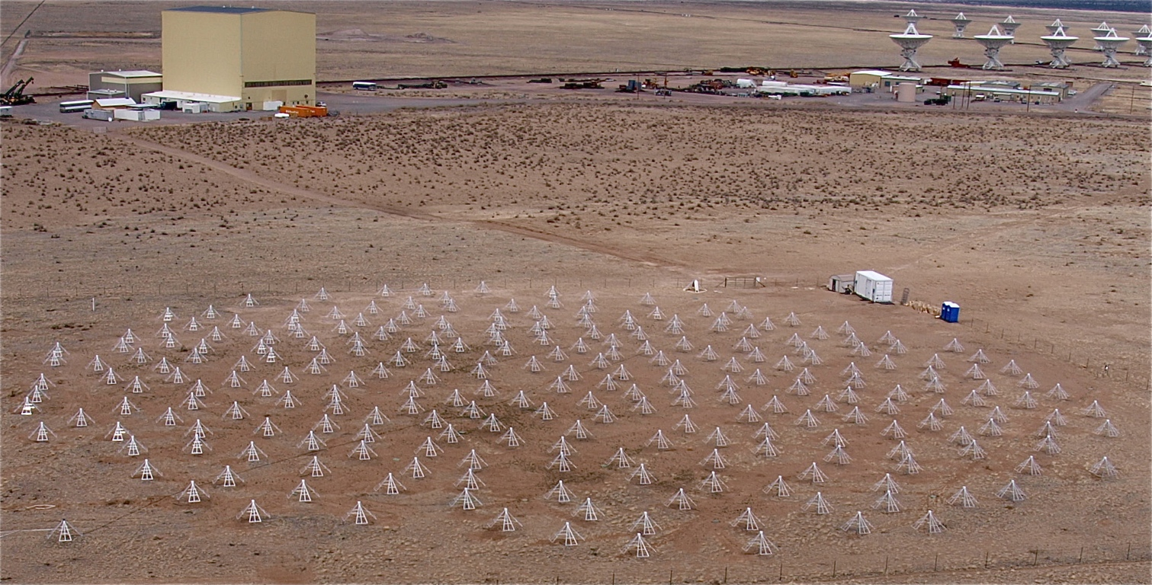
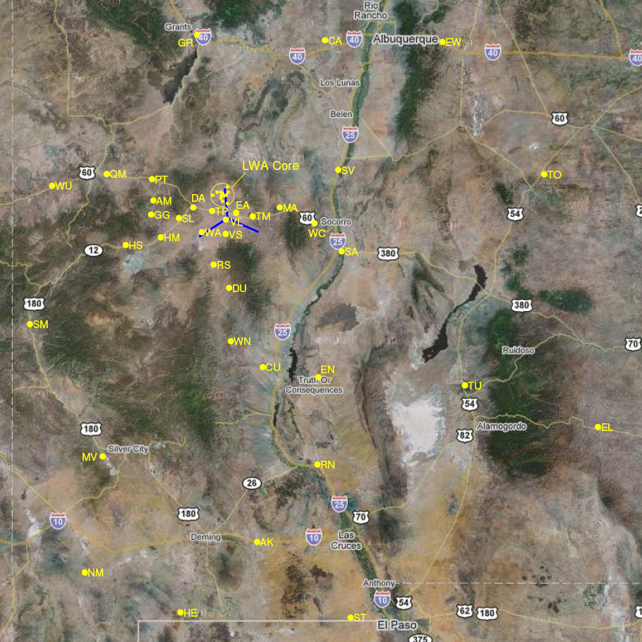
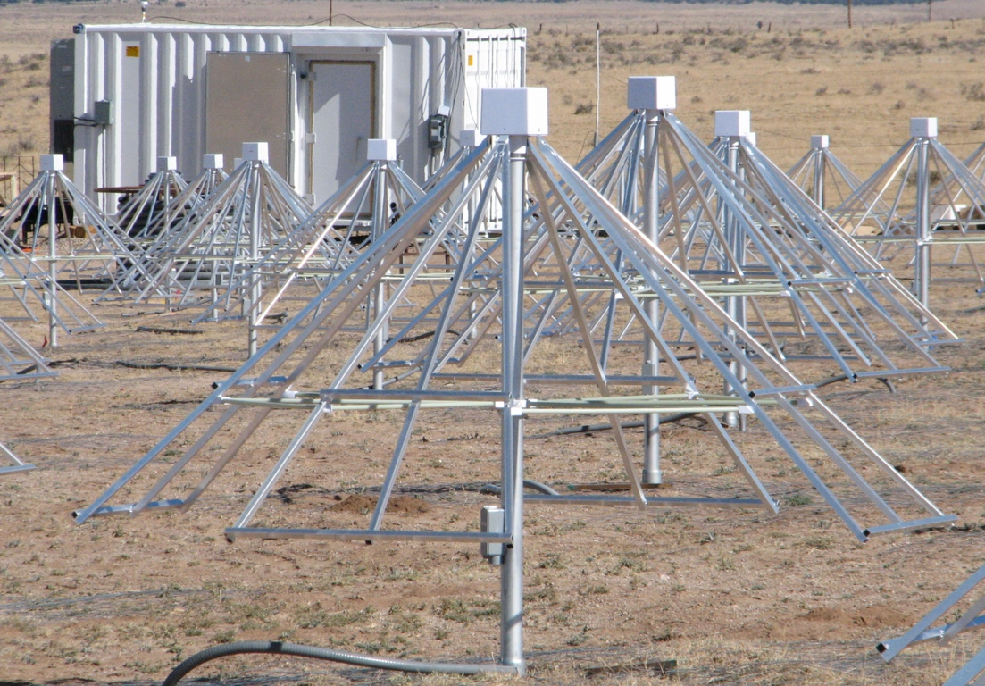
The LWA Instrument
10-88 MHz Aperture Synthesis Telescope
4 beams x 2 pol. x 2 tunings x 16 MHz
2 all-sky transient obs. modes
LWA1
State of New Mexico, USA
LWA1 operational in 2011
Goal of 53 LWA stations, baselines up to 400 km for resolution 2” at 80 MHz with mJy sensitivity
Cost is ~$1M/station

Slide 7
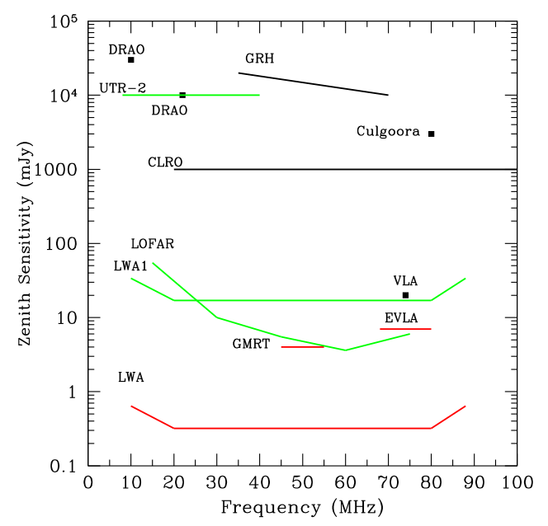
Comparison to other instruments
Declination Range Δν
(MHz)
UTR2: -30° to +60° 33
LOFAR: -11° to +90° 16
Y=VLA:-35° to +90° 3
LWA1: -30° to +90° 16
GMRT: -53° to +90° 10
LWA1 has sensitivity ~25% of all of LOFAR

Slide 8
Pathfinding
LWA – EVLA linkages
Coordinated Observing (e.g., LWA1 transient triggers EVLA)
EVLA 74 MHz upgrades
LWA1 tied into EVLA through WIDAR
LWA1 and space weather
Long Wavelength Intermediate Array (LWIA)
LWAHM under lease, 2 other sites approved
Long Wavelength Array – 53 stations
LWA1 as Pathfinder to DARE, HERA, …

Slide 9
LWA1 Operators
Joe Craig
Jayce Dowell
Steve Ellingson
Jake Hartman
Ken Obenberger
Ylva Pihlstrom
Frank Schinzel
Greg Taylor
Hank Tillman
Genevieve Vaive
Chris Wolfe

Slide 10
Thank You for your Support!

Slide 11
Backup Slides

