Slide 1
LWA1 User Programs Report
Y. Pihlström (UNM)

Slide 2
Outline
User Programs purpose and functions
Usefull webpages
Plans for a data base
CFP1 report
CFP2 report

Slide 3
LWA1 User Program Purpose
To provide support for users
Provide information about telescope for proposal preparation (web page)
Provide information about observation preparation (web page)
Provide RFI monitoring information (web page, to be implemented)
Help with SDFs/verifying SDFs
Provide data reduction software (LSL, see talk by Dowell)
Compile useful data reduction scripts and hints
Data retrieval

Slide 4
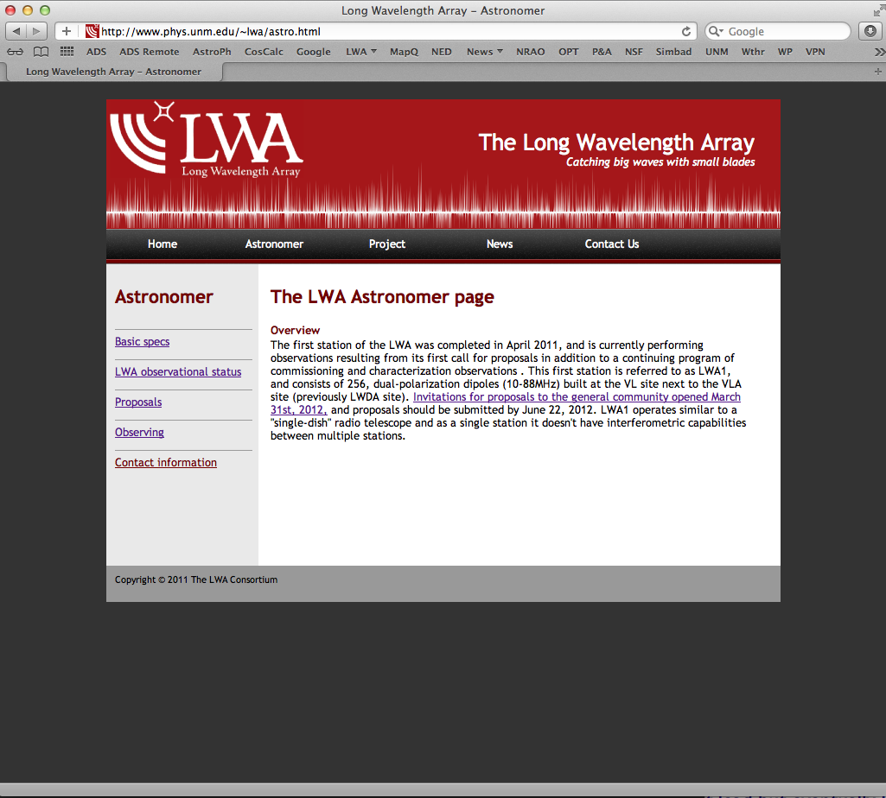

Slide 5
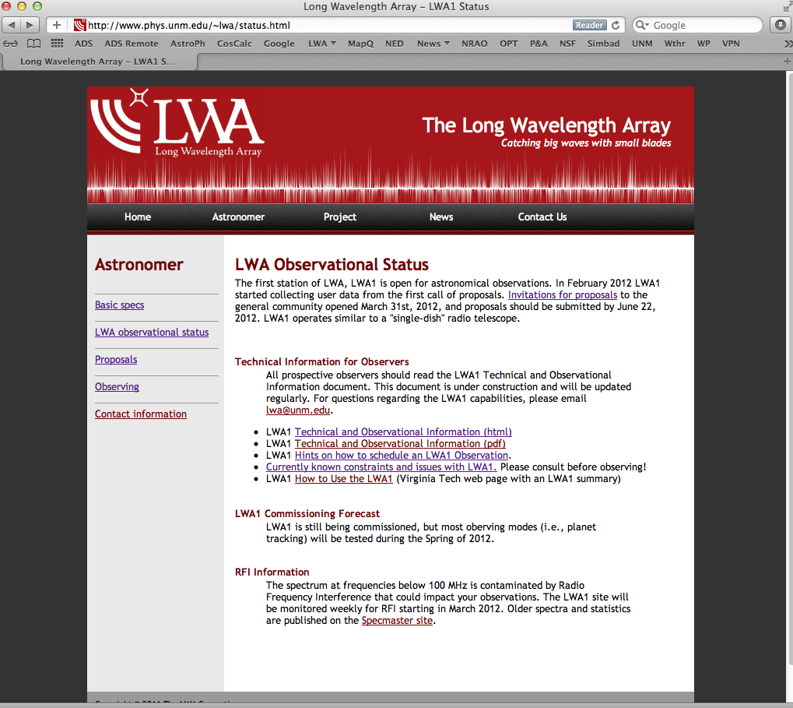
http://www.phys.unm.edu/~lwa/status.html

Slide 6
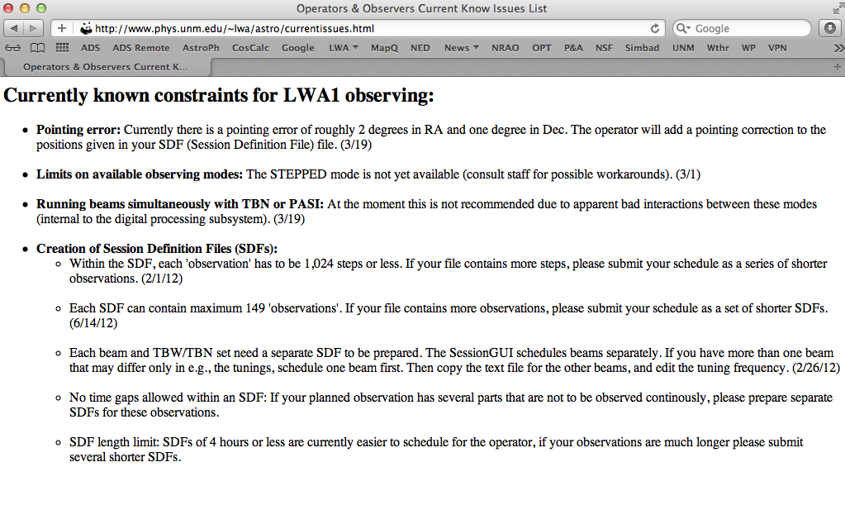
http://www.phys.unm.edu/~lwa/astro/currentissues.html

Slide 7
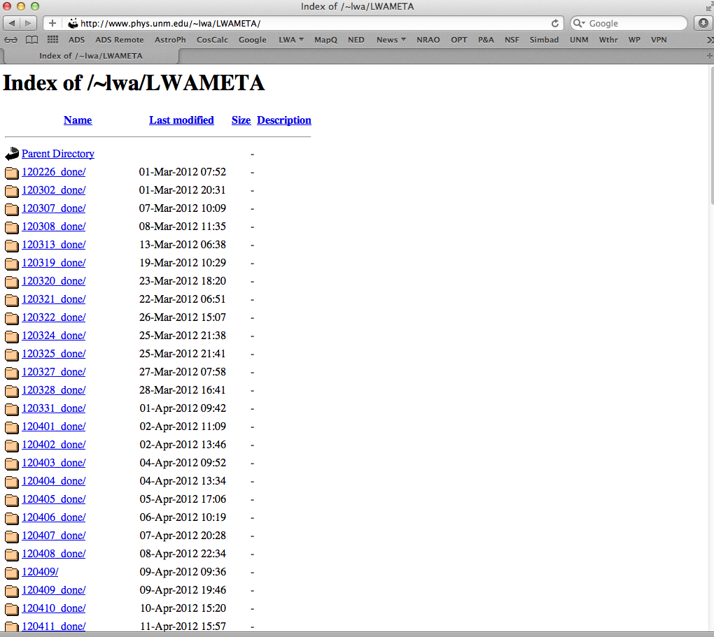
Find your LWA1 metadata at:
http://www.phys.unm.edu/~lwa/LWAMETA/
Description of metadata in document MCS0031

Slide 8
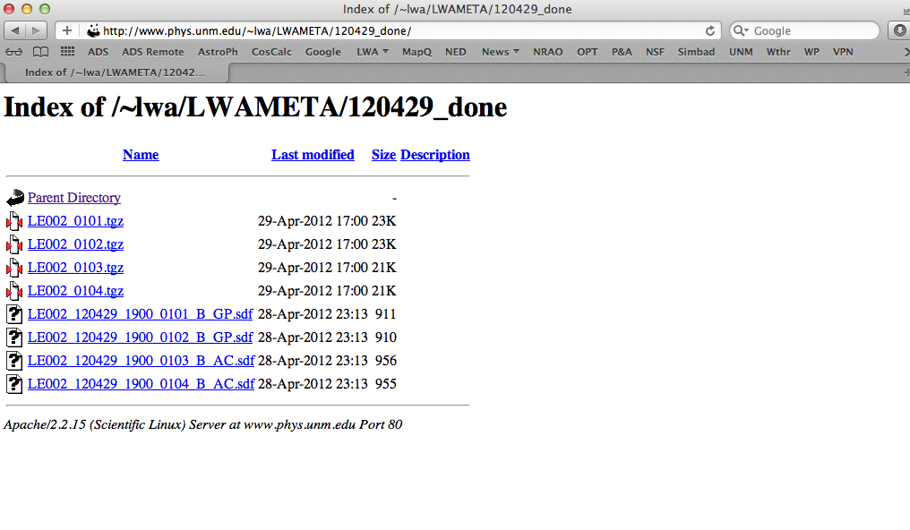
Find tar balls with metadata and the SDFs that were used for the observations (many are corrected for pointing errors and time shifts compared to the submitted SDFs).

Slide 9
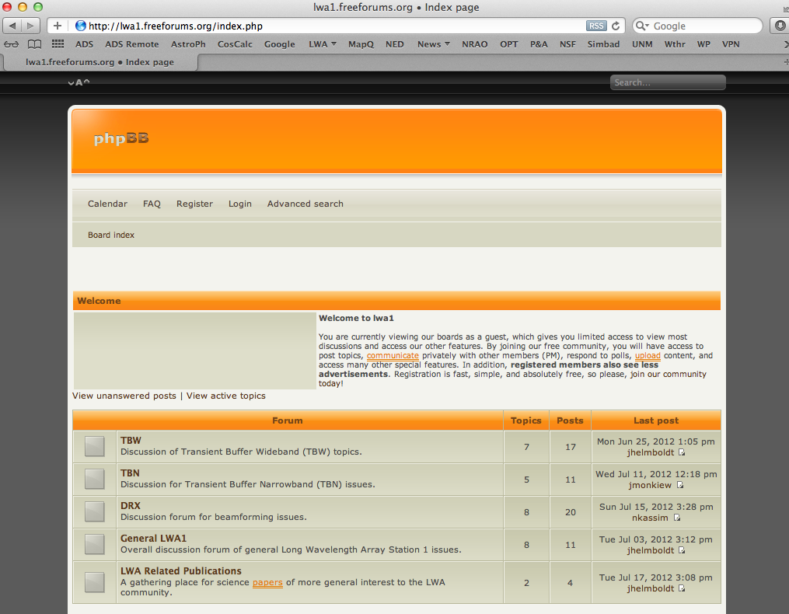
User forum
http://lwa1.freeforums.org/index.php
Coordinated by NRL
LWA Science consortium meetings (telecons once/month)
Notes:
To get help from other novice users, to show pics, throw out ideas & questions

Slide 10
User Program Purpose cont.
Observing support and administration
Verify submitted SDFs
Prepare weekly observing schedules and ready-to-observe files for operators
Keep track of observed hours
Handling call for proposals
Data archive
Future enhancements
RFI monitoring
Data base with search functions for users
Observed sources
Details and status of specific projects

Slide 11
Data Archive
http://lda10g.alliance.unm.edu/
Connected with 10GbE, via National Lambda Rail
Stored files:
Raw DP (spectrometer) files
Reduced DRX files in HDF5 format
MCS metadata tarballs
Currently 28 TB storage, will soon be expanded with another 19 TB
Current search features:
Observing mode
Project code
LST coverage

Slide 12
LWA1 Data Base
Goal: Single database where information about each project is kept
Collection of SDFs (or list thereof) to final data shipping status
Archive of what observations that have taken place
Archive of logs and metadata
Three main users:
Scheduler
Operator
User

Slide 13
LWA1 Data Base cont.
Scheduler will:
Prepare for observations (upload SDFs and weekly observing schedules)
Set SDF priorities
Keep track of each project’s status
Operator will:
Find what schedules to observe when, and option to e.g. search for all SDFs in queue that are observable within a given LST range
Log information about observations and save the SDFs that were run

Slide 14
LWA1 Data Base cont.
User will:
Search for project status and metadata for a given project ID
Can access log files for given project ID
Search for what sources have been observed and in what mode (frequency, DRX settings etc) using either source name or RA/Dec.
All in one data base but different user interfaces via a web page query-based form
Work by UNM graduate student Genevieve Vaive

Slide 15
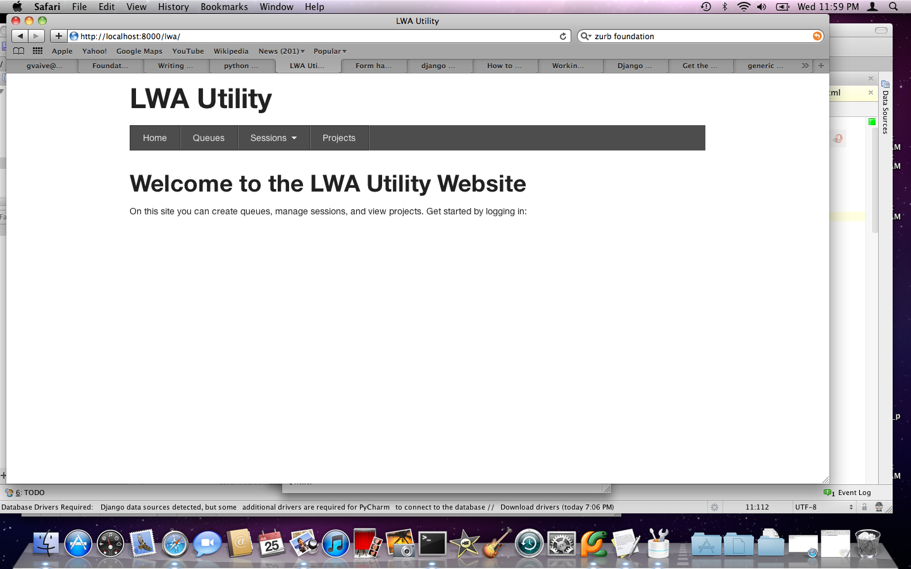

Slide 16
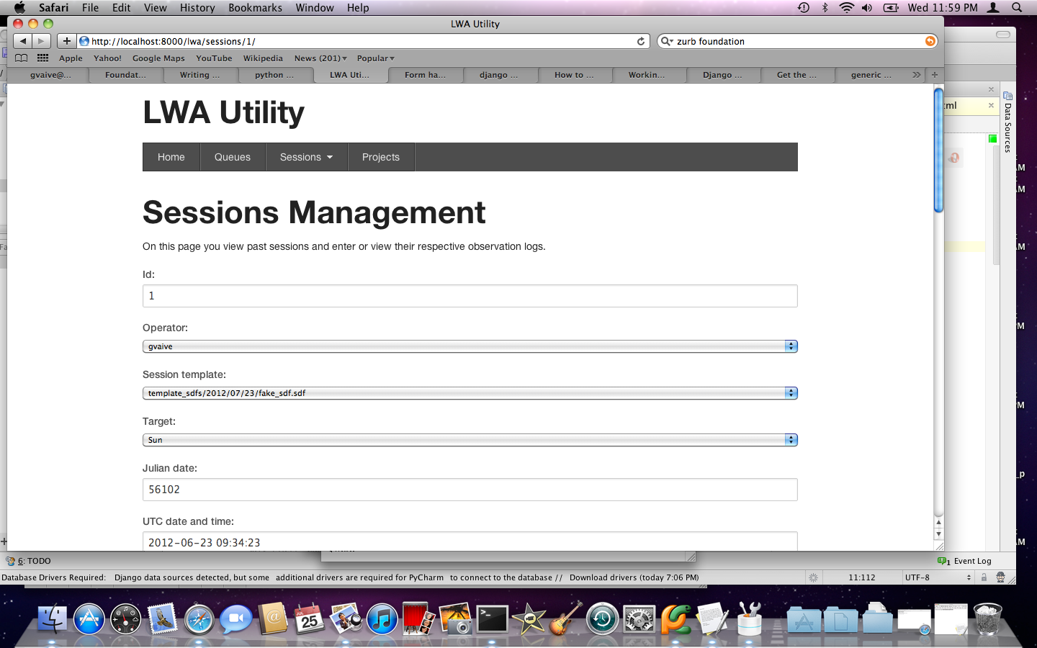

Slide 17
CFP1 summary
Internal collaboration proposals with the aim of doing scientific testing of LWA1
Proposal deadline October 30th, 2009
15 proposals received for ~4500 beam hours
Observations started in end of January, 2012

Slide 18
CFP1 Research Topics
Transients – 3
Ionosphere - 2
Pulsars – 2
Planetary - 1
Exosolar planets - 1
Solar - 1
RRLs – 1
Cosmic Rays - 1
Other - 3
Notes:
Other – sky survey, Cas A/Cyg A flux ratio, passive meteor scattering

Slide 19
CFP1 PI Demographics
PI’s from 7 different institutions:
AFRL, LIU, NRL, Stanford, Univ. of Kansas, UNM, Virginia Tech
PI’s and Co-I’s from 17 different institutions:
AFRL, Case Western, JPL, LANL, LIU, Middle Tennessee State Univ., NMT, NRAO, NRL, Swinburne Univ., The College of NJ, Univ. of California SD, Univ. of Kansas, Univ. of Md, UNM, Univ. of Tasmania, Virginia Tech

Slide 20
CFP1 Completion Summary 120723
Code Allocated Observed Percent
beam hrs beam hrs completed
-------------------------------------------------------------------------
LC001 56 89.38 160
LC002 344 236.5 69
LE001 320 2.75 0.9
LE002 640 153.39 24.0
LH001 6 14.34 239
LH002 300 429.32 143.1
LK001 580 138 23.8
LP001 378 204 54
LP002 672 9 1
LR001 50 69.5 139
LS001 320 197.2 59.1
LW001 320 41 12.8
Total number of DRX beam hrs in CFP1: 3986
Percentage completed: 40% (1584.38 hrs)

Slide 21
PC Completion Summary 120723
Programmatic Commitment Completion Summary
Code Allocated Observed Percent
beam hrs beam hrs completed
-------------------------------------------------------------------------
LB002 520 24 4.6
LG001 300 0 0
Total number of DRX beam hrs in PC: 820
Percentage completed: 3% (24 hrs)

Slide 22
CFP2 summary
Call went out in March
Proposal deadline June 22nd, 2012
17 proposals received, for 9162 beam hours (out of 1000 beam hours advertised in CFP2)
TAC meeting next week – stay tuned for results to be distributed around Aug. 8
Observations to start Sep. 1st

Slide 23
CFP2 PI Demographics
PI’s from 12 different institutions:
AFRL, JPL, LIU, Middle Tennessee State Univ., NRAO, NRL, Stanford, Sweet Briar College, UNM, UMd, Univ. of Texas at Brownesville, Virginia Tech
PI’s and Co-I’s from 17 different institutions:
AFRL, Caltech, Eureka Scientific, JPL, LIU, Middle Tennessee State Univ., NRAO, NRL, RF Associates, Stanford, Sweet Briar College, Swinburne Univ., The College of NJ, Univ. of Florida, UNM, UMd, Univ. of Texas at Brownesville, Virginia Tech
In CFP2 we gained 23 new users (8 new PIs)!

Slide 24
CFP2 Research Topics
Ionospheric – 5 proposals
Pulsars – 4 proposals
Transients – 2 proposals
Planetary – 1 proposal
Exosolar – 1 proposal
Solar – 1 proposal
Lightning/weather – 1 proposal
Other – 2 proposals
Notes:
Other – radar imaging of terrain features and CygA/CasA flux ratio

Slide 25
Notes:
Based on 1560 hours

