Slide 1
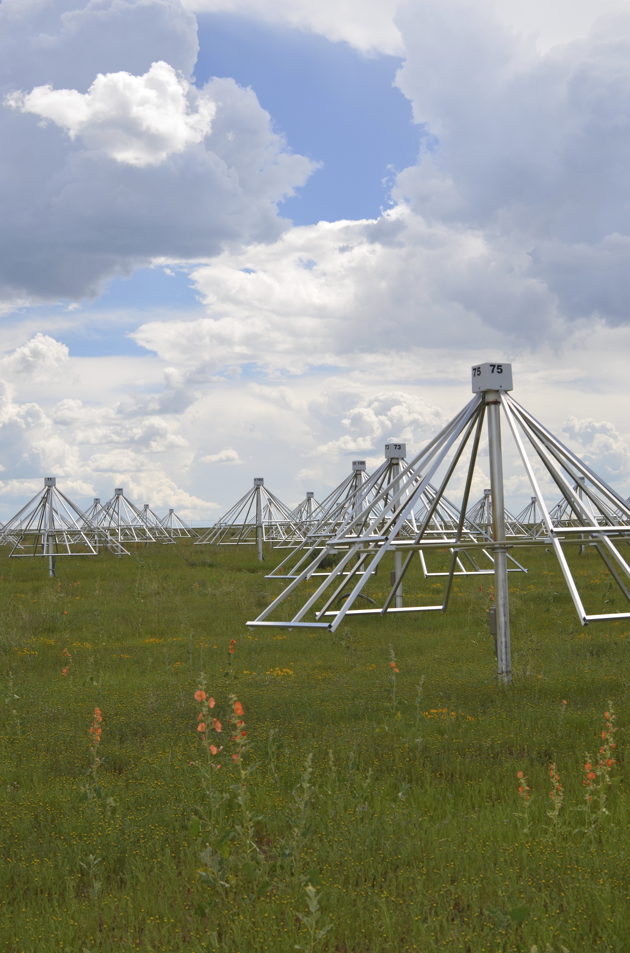




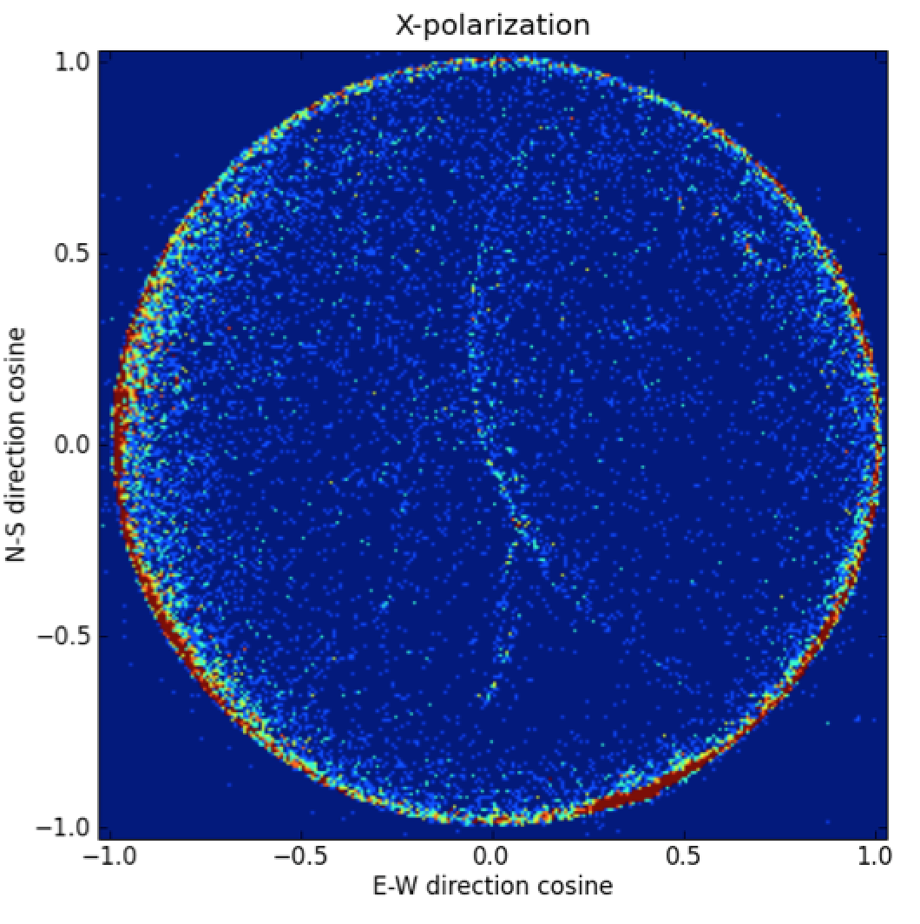
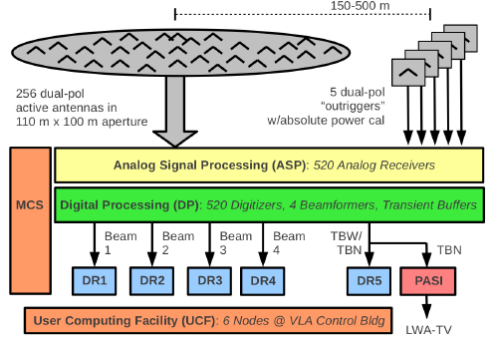
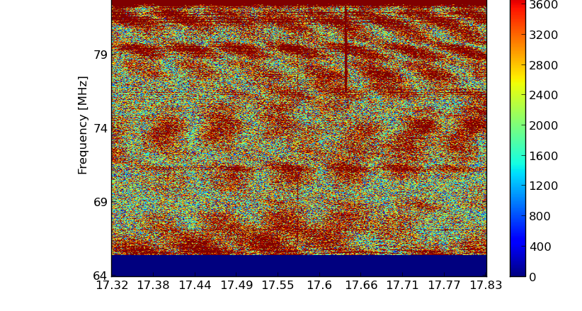
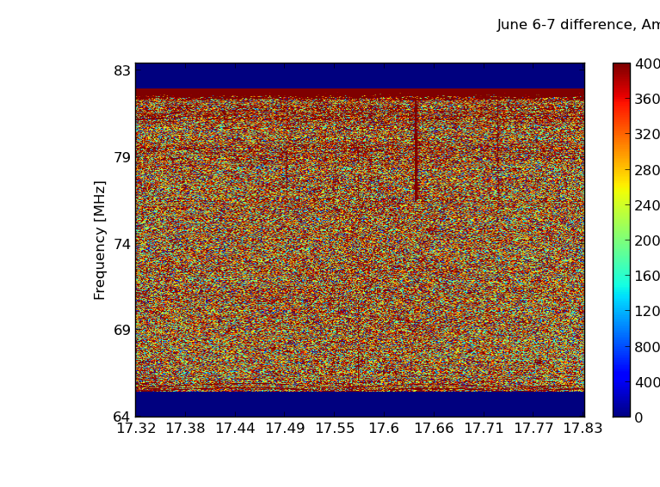
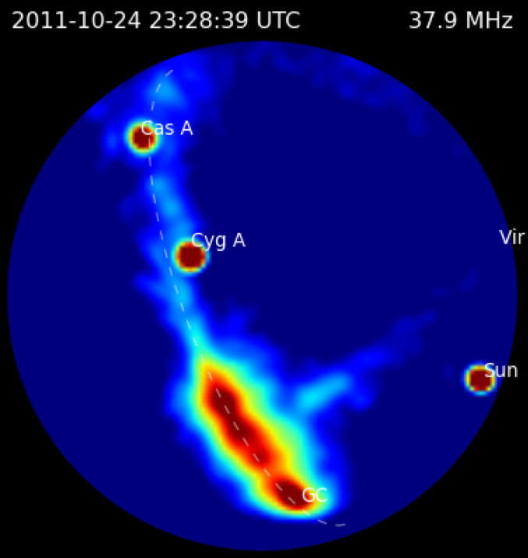
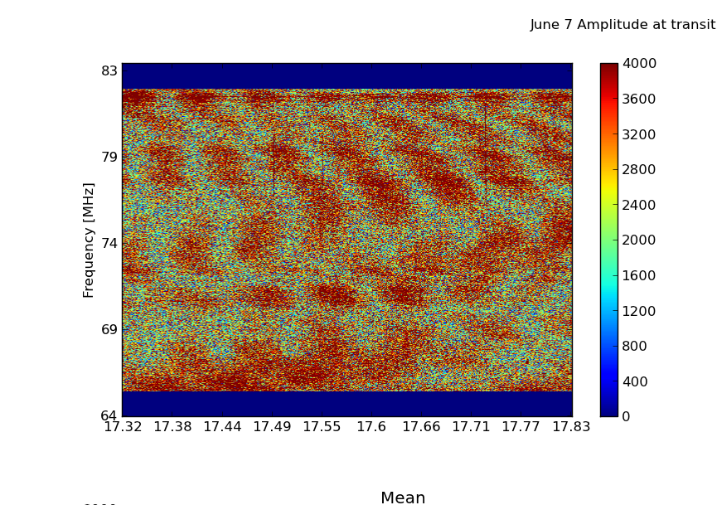
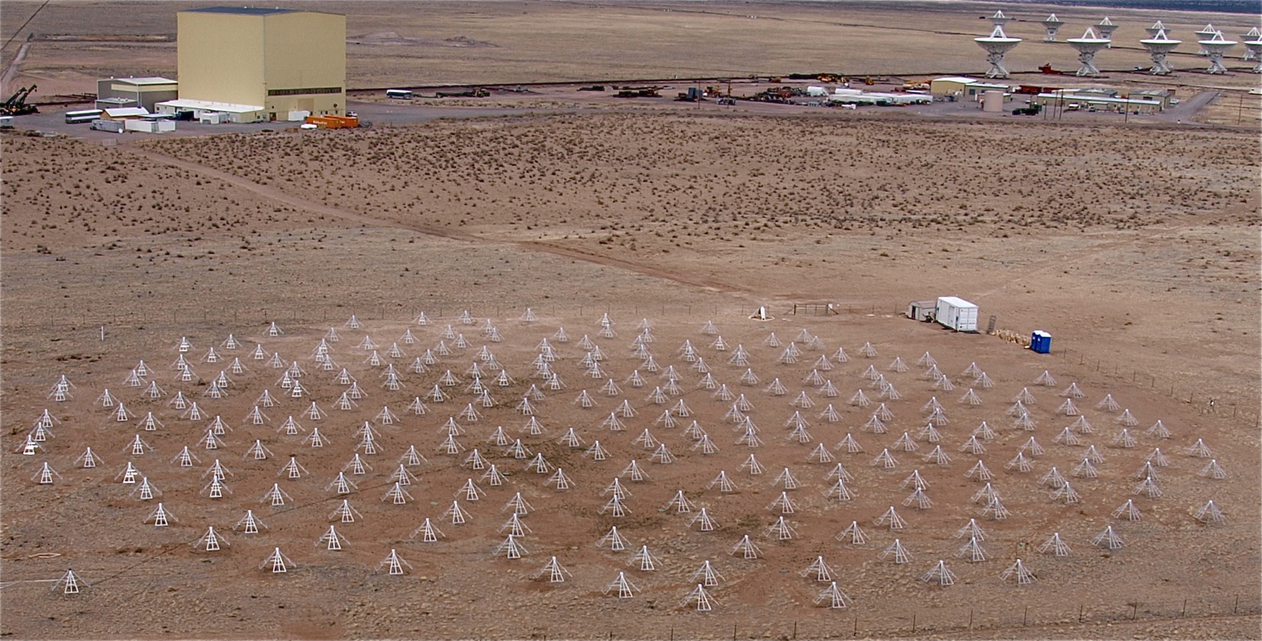
Monitoring the Galactic Center with the
Long Wavelength Array
Greg Taylor (UNM) on behalf of the Long Wavelength Array Collaboration
http://lwa.unm.edu
LWA1 Science
LWA1 is a radio telescope operating between 10 and 88 MHZ in New Mexico, USA. The 520 dipoles provide excellent sensitivity
LWA1 supports a variety of science cases from the ionosphere to the dark ages
Recent results include studies of the neutral wind in the ionosphere via meteor trails and detection of the millisecond pulsar J2145-0750
LWA1 Architecture
LWA1 provides 4 independent beams, each 16 MHz wide
  or a signal from all dipoles (100 KHz continuous or 98 MHz but only for 61 msec every 5 min)
The LWA Software Library (LSL) provides analysis tools for working with LWA1 data
The LWA Users Computing Facility with 50 TB of disk provides computing co-located with the data collection for fast analysis
J2145-0750
(Dowell et al.
2013, ApJL)
Meteor Trails
(Helmboldt, in prep.)
Proposals Due Nov. 1
Co-location of processing with data leads to faster data analysis
All-sky Monitoring
Galactic Center Campaign
38 MHz
Multiple beams, wide bandwidth
Nightly observations from May 1 – June 8
~4 hours each night covering galactic center
transit
June 6, 19 MHz BW, 30 minute scan
Dowell et al. 2012
Software correlator and imager
Receives a 100 KHz stream from all 520 dipoles
Near-real-time imaging at 1 sec cadence
100% duty cycle covering 3p steradians
Hartman et al. 2013, in prep.
Difference of June 6 and 7 scans
Resolution: 4 seconds, 4.7 KHz pixels
LWA1
June 7, 19 MHz BW, 30 minute scan
Cutchin, Hyman, Kassim et al. 2013, in prep
Can realize ~50X and 15X improvements in sensitivity by averaging in BW and time, respectively: approach 1 Jy rms!
Construction of the LWA has been supported by the Office of Naval Research under Contract N00014-07-C-0147.
Support for operations and continuing development of the LWA1 is provided by the National Science Foundation under grants AST-1139963 and AST-1139974 of the University Radio Observatory program.

